Slide 1

Leveraging Web Services – A Real World Example
Notes:
We’re excited to be here at the ColdFusion summit and are looking forward to learning new things and see how the future of ColdFusion can continue to drive solutions at Thermo Fisher Scientific and help our customers make the world healthier, cleaner and safer. <click mouse>

Slide 2

Supply Center Solutions
Notes:
We’re excited to be here at the ColdFusion summit and are looking forward to learning new things and see how the future of ColdFusion can continue to drive solutions at Thermo Fisher Scientific and help our customers make the world healthier, cleaner and safer. <click mouse>

Slide 3
Keen Haynes
Doug Rehg
Senior ColdFusion Engineer
17+ years with ColdFusion
keen.haynes@thermofisher.com
Senior ColdFusion Engineer
15+ years with ColdFusion
doug.rehg@thermofisher.com
Notes:
Keen Haynes and Doug Rehg

Slide 4
What This Is – What It Is Not
This is not a “best practices” discussion but
real world overview of how we did it at
ThermoFisher and how we changed our
approach with CF2016 and the API Manager
Notes:
This is not a “best practices” discussion but real world overview of how we did it at ThermoFisher and how we changed our approach with CF2016

Slide 5
Agenda
Soap Example
RESTful Example
Our Challenge
Decisions We Faced
  REST VS SOAP
  Authentication
  Tracking
Leveraging CF 2016 and the API Manager
  Security
  Testing
  Swagger Docs
  Dashboard (Tracking)
Application Demo
Questions
Notes:
Agenda Items

Slide 6
Basic SOAP
<cfcomponent output="false" style="document">
<cffunction name=" getAuthorDetails " access="remote" output="no" returntype=" query” hint=“returns author details”>
  <cfargument name="authorid" required=“false" default=“0” type=“numeric”>
  <cfquery name="qAuthorDetails" datasource="#request.readDSN#">
  select * from app.authors
  <cfif arguments.authorid>
  where authorid = #arguments.authorid#
  </cfif>
  </cfquery>
  <cfreturn qAuthorDetails>
  </cffunction>
</cfcomponent>
Notes:
Note argument required equals false

Slide 7
Calling SOAP
Pass Optional argument with value
<cfinvoke webservice="http://localhost/webservices/authorSoap.cfc?wsdl"
method=" getAuthorDetails " returnvariable=“authDetails">
<cfinvokeargument name=“authorid" value=“5" />
</cfinvoke>
Pass Optional argument without value
<cfinvoke webservice="http://localhost/webservices/authorSoap.cfc?wsdl"
method=" getAuthorDetails " returnvariable=“authDetails">
<cfinvokeargument name=“authorid" value=““ omit=“true” />
</cfinvoke>
Notes:
If no value is passed you need omit equals false

Slide 8
Basic REST
<cfcomponent rest="true" restpath="/authors" displayname="authors" >
  <cffunction name="getAuthorDetails" access="remote" httpmethod="GET" returntype="any" restpath="{authorid}" produces="application/xml">
  <cfargument name="authorid" required="true" restargsource="Path"/>
  <cfquery name="qAuthorDetails" datasource="#request.readDSN#">
  select * from app.authors
  where authorid = #arguments.authorid#
  </cfquery>
  <cfreturn qAuthorDetails>
  </cffunction>
</cfcomponent>

Slide 9
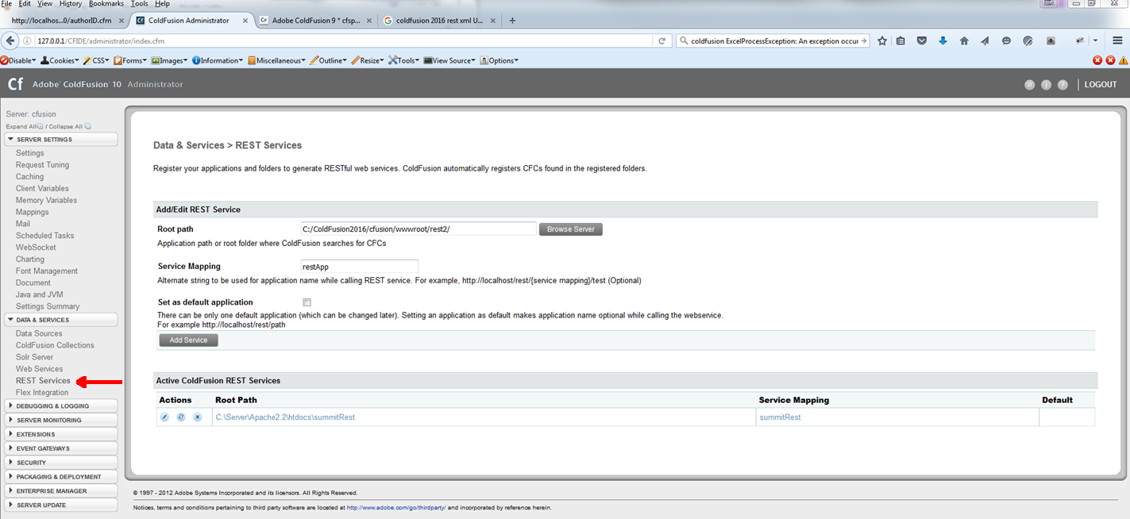
Register Your REST Service - ColdFusion 10
Notes:
Registering Rest service in ColdFusion 10

Slide 10
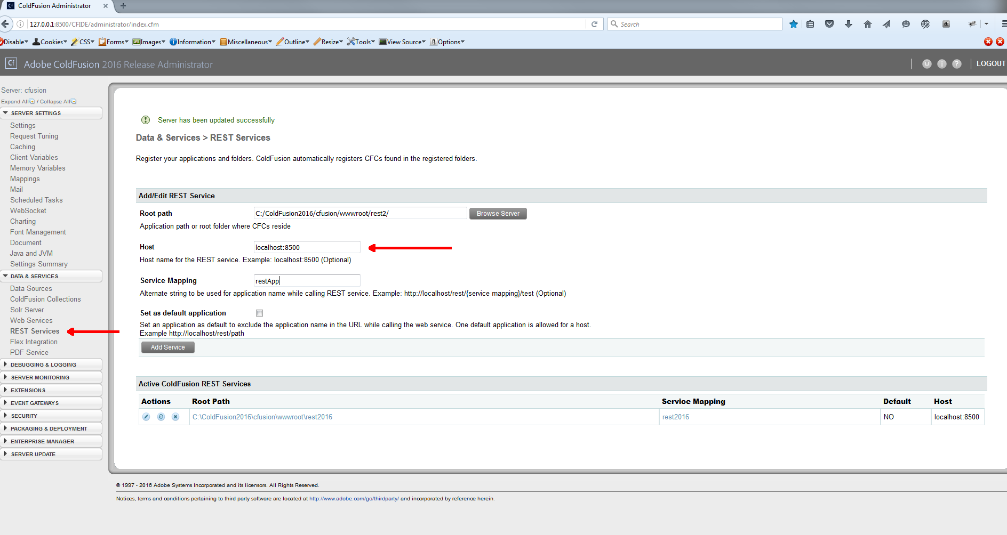
Register Your REST Service - CF2016
Notes:
Registering your REST in CF2016. Note the “host” value which allows for multiple sites

Slide 11
Calling Your REST Service
<cfhttp url="http://localhost/rest/summitRest/authors/1" result="restResult" method="get">
</cfhttp>
Notes:
Simple cfhhpt call to REST service

Slide 12
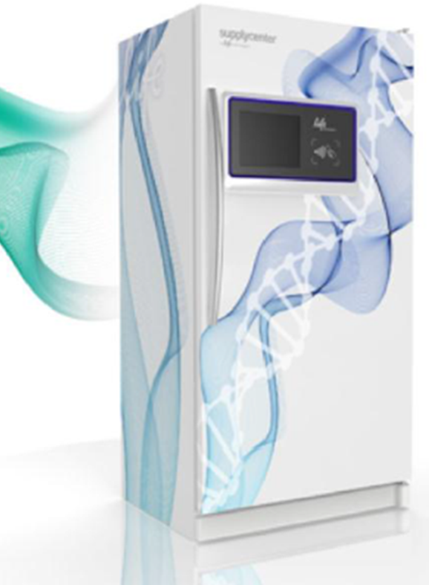
Our Challenge
Provide our customers access to Thermo Fisher products real time on their own campus
Make it super simple for customers to purchase and retrieve our products
The products needed to be securely stored and refrigerated
Inventory and replenishment needed to be automatic
Notes:
Our challenge (read the bullet points)

Slide 13

Decisions We Faced
MIDDLEWARE
(Corporate Architecture Requirement)
SOAP VS. RESTful
DOCUMENTATION
APP LAYER
TESTING
SECURITY
DB
Notes:
Decisions We Faced (read the bullet points)

Slide 14
Initial Solution – SOAP VS. RESTful
Soap
RESTful not supported by CF8
Middleware utilized SOAP
RESTful
CF 10 introduced REST support
Approval to bypass middleware
Notes:
Soap VS. REST Initially we were on CF8 for Premier units and had moved to CF10 when we started on our Express units

Slide 15
Initial Solution – SOAP VS. RESTful
SOAP
Documentation
  WSDL
Testing
  Custom CFML Test Harnesses
  SOAP UI
Security
  Security handled by Oracle OFM Middleware – Server Recognition
RESTful
Documentation
  No self documenting tools for REST
  Unfamiliar with SWAGGER
  Hand coded in CFML
Testing
  Custom CFML Test Harnesses
  POSTMAN / BOOMERANG
Security
  Coded
Notes:
More SOAP VS. RESTful

Slide 16
Initial Solution – Books RESTful Code Snippet
<cfcomponent rest="true" restpath="/books" displayname="books" extends="packetTracking">
<cffunction name="getBookDetailsJSON" access="remote" httpmethod="GET" returntype="any" restpath="{bookid}" produces="application/json">
<cfargument name="bookid" required="true" restargsource="Path" type="string">
<cfinclude template="inc_tracking.cfm">
<cfquery name="qBookDetails" datasource="#request.readDSN#">
select b.bookid, a.firstname, a.lastname, a.authorid, b.title, b.bookimage, b.bookdescription, b.isspotlight, b.genre
from app.books b, app.authors a
where a.authorid = b.authorid
and b.bookid = #arguments.bookid#
</cfquery>
<cfset temp = restThrow(throw="false", errorCode="200", message="OK", detail="Action completed successfully.", data="#serializeJSON(qBookDetails)#", sourcename="#getfunctioncalledname()#")>
<cfreturn qBookDetails>
</cffunction>

Slide 17
Initial Solution – inc_tracking.cfm Snippet
<cfset httpRequest = getHTTPRequestData()>
<cfset request.rest = {}>
<cfset request.rest["sessionId"] = createUUID()>
<cfset request.rest["tsStart"] = now()>
<cfset request.rest["restPath"] = CGI.PATH_INFO>
<cfif isDefined('httpRequest.Headers.Authorization')>
<cfset request.rest["authString"] = ToString(ToBinary( ListLast(GetHTTPRequestData().Headers.Authorization," ") ))>
<cfset request.rest["memberEmail"] = ListFirst(request.rest.authString,":")>
<cfset request.rest["memberPassword"] = ListLast(request.rest.authString,":")>
<cfelse>
<cfset request.rest["authString"] = "NA">
<cfset request.rest["memberEmail"] = "NA">
<cfset request.rest["memberPassword"] = "NA">
</cfif>
<cfset theDir=GetDirectoryFromPath(GetCurrentTemplatePath())>
<cfset packetFileName = theDir & "packetTracker.xls">

Slide 18
Initial Solution – inc_tracking.cfm cont.
<cfif FileExists(packetFileName)>
<cfspreadsheet action="read" src="#packetFileName#" sheetname="packets" name="packetTracker">
<cfset spreadsheetAddRow(packetTracker,"#request.rest.sessionId#,#request.rest.restPath# , #request.rest.authString#,,,,,#request.rest.tsStart#",2,1)>
<cfspreadsheet action="write" filename="#packetFileName#" name="packetTracker" sheetname="packets" overwrite=true>
<cfelse>
<cfset theSheet = SpreadsheetNew("packetTracker")>
<cfset spreadsheetAddRow(theSheet,"sessionId,restPath,authString,responseStatusCode, responseStatusMessage,responseStatusDetail,responseData,tsStart,tsEnd",1,1)>
<cfset spreadsheetAddRow(theSheet,"#request.rest.sessionId#,#request.rest.restPath#, #request.rest.authString#,,,,,#request.rest.tsStart#",2,1)>
<cfspreadsheet action="write" filename="#packetFileName#" name="theSheet" sheetname="packets" overwrite=true>
</cfif>

Slide 19
Initial Solution – tracking.cfc Snippet
<cffunction name="restThrow" returntype="STRING">
<cfargument name="errorcode" type="any" default="" required="false">
<cfargument name="message" type="string" default="" required="false">
<cfargument name="detail" type="string" default="" required="false">
<cfargument name="data" type="string" default="" required="false">
<cfargument name="throw" type="boolean" default="true" required="false" hint="determines whether or not to throw the actual exception">
<cfargument name="sendNotification" type="string" default="AllNon200s">
<cfargument name="sourcename" type="string" default="none">
<cfset returnval = serializeJSON(arguments)>
<cfset theDir=GetDirectoryFromPath(GetCurrentTemplatePath())>
<cfset packetFileName = theDir & "packetTracker.xls“>
<cfspreadsheet action="read" src="#packetFileName#" sheetname="packets" name="theSheet">
<cfset spreadsheetAddRow(theSheet, #request.rest.sessionId#,,,#arguments.errorcode#, #arguments.message#,#arguments.detail#,'#arguments.data#',,#NOW()#",2,1)>
<cfspreadsheet action="write" filename="#packetFileName#" name="theSheet" sheetname="packets" overwrite=true>
Notes:
Note cfspreadsheet……read then add row then write

Slide 20
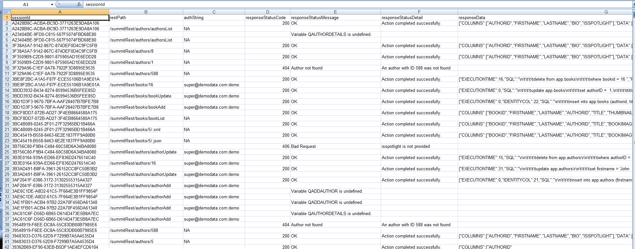
Manual Tracking Spreadsheet

Slide 21
Initial Solution – Books RESTful Code Snippet
<cffunction name="addBook" access="remote" httpmethod="POST" returntype="any" restpath="bookAdd">
<cfargument name="structData" type="struct" required="true" >
<cfinclude template="inc_tracking.cfm">
<cfinclude template="inc_auth.cfm"> ←Security Call
<cfquery name="qAddBook" datasource="#request.readDSN#" result="insertResults">
insert into app.books (authorid, title, bookimage,thumbnailimage, bookdescription, isspotlight, genre)
values (#structData.authorid#, '#trim(structData.title)#', '#trim(structData.bookimage)#', '#trim(structData.thumbnailimage)#', '#trim(structData.bookdescription)#', '#structData.isspotlight#', '#trim(structData.genre)#')
</cfquery>
<cfset temp = restThrow(throw="false", errorCode="200", message="OK", detail="Action completed successfully.", data="#serializeJSON(insertResults)#", sourcename="#getfunctioncalledname()#")>
<cfreturn insertResults>
</cffunction>

Slide 22
Initial Solution – Calling API With Security
<cfset variables.startStr = "super@demodata.com:demo">
<cfset variables.base64Str = toBase64(variables.startStr)>
<cfset variables.jsonStr = {firstname="John", lastname="Stone", bio="John is from Carlsbad CA", isspotlight ="Y"}>
<cfset variables.dataString = SerializeJSON(variables.jsonStr)>
<cfhttp url="http://localhost/rest/summitRest/authors/authorAdd" result="restResult" method="post">
<cfhttpparam TYPE="Header"
name="content-type"
value="application/JSON">
<cfhttpparam type="Header"
name="Authorization"
value="#variables.base64Str#">
<cfhttpparam TYPE="Body"
name="structData"
value="#variables.dataString#">
</cfhttp>
<cfdump var="#restResult#">

Slide 23
Initial Solution – inc_auth.cfm
<cfset LOCAL.EncodedCredentials = GetHTTPRequestData().Headers.Authorization>
<cfset LOCAL.Credentials = ToString(ToBinary( LOCAL.EncodedCredentials ))>
<cfset LOCAL.memberEmail = ListFirst( LOCAL.Credentials, ":" )>
<cfset LOCAL.memberPassword = ListLast( LOCAL.Credentials, ":" )>
<cfquery name="getMember" datasource="#request.readDSN#">
  select *
  from app.members
  where lower(email)='#lcase(LOCAL.memberEmail)#'
  and memberpassword='#LOCAL.memberPassword#'
  and isactive = 'Y'
</cfquery>
<cfif getMember.recordcount EQ "0">
<cfthrow errorcode="401" message="Unauthorized!" type="401" detail="Username or Password incorrect">
<cfelse>
  <cfset arguments.memberid = getMember.memberid>
  <cfset arguments.memberfname = getMember.firstname>
  <cfset arguments.memberlname = getMember.lastname>
  <cfset arguments.memberemail = getMember.email>
  <cfset arguments.memberisadmin = getMember.isadmin>
</cfif>

Slide 24
ColdFusion 2016 and API Manager
Then Came CF 2016
And
The API Manager

Slide 25
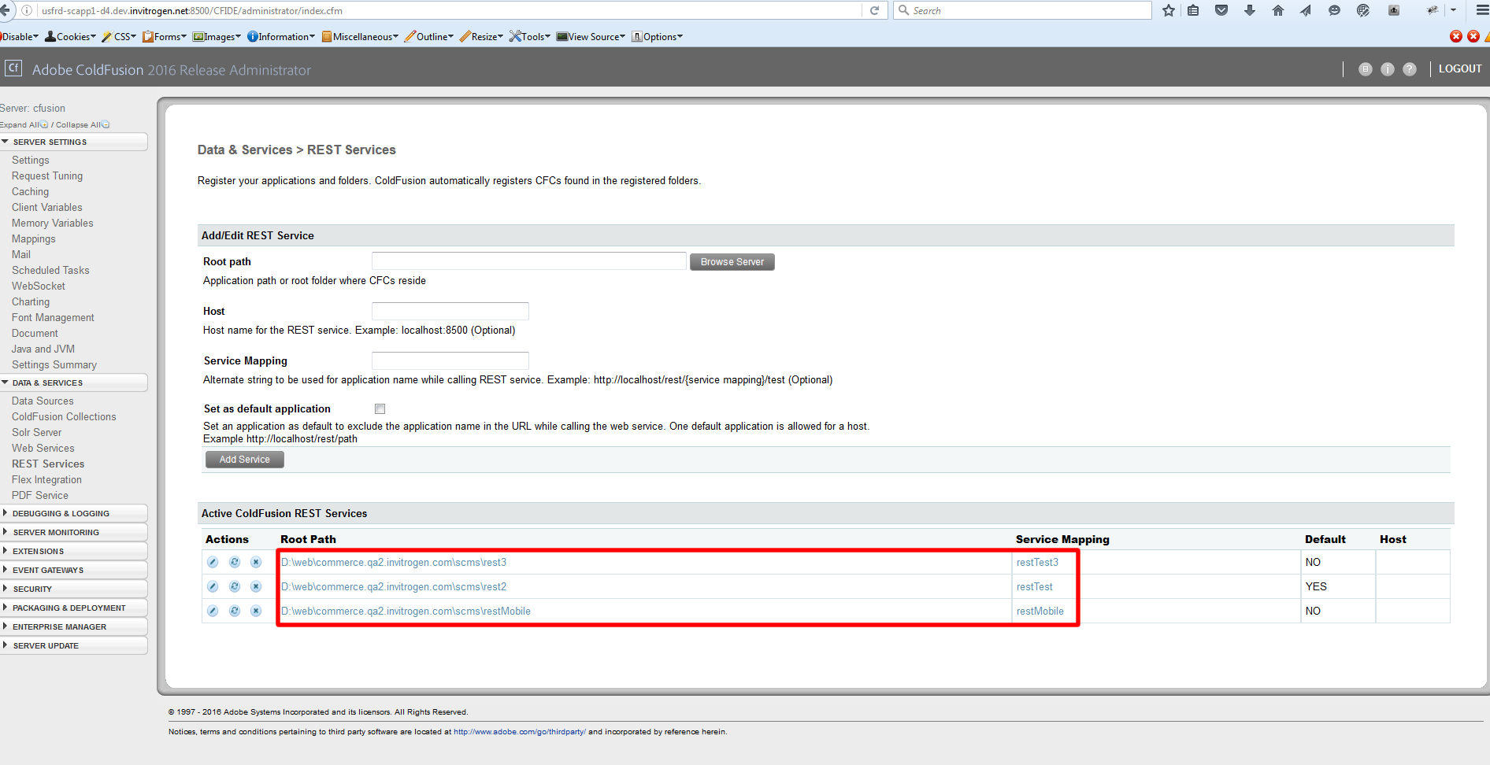
Create API – Registered REST services

Slide 26
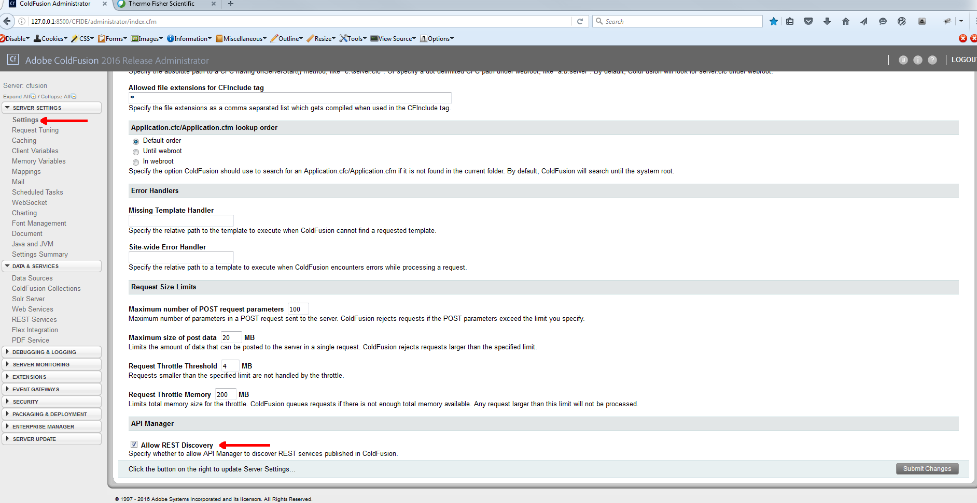
CF2016 Administrator – Allow REST Discovery
Notes:
Will allow discovery of registered REST services

Slide 27
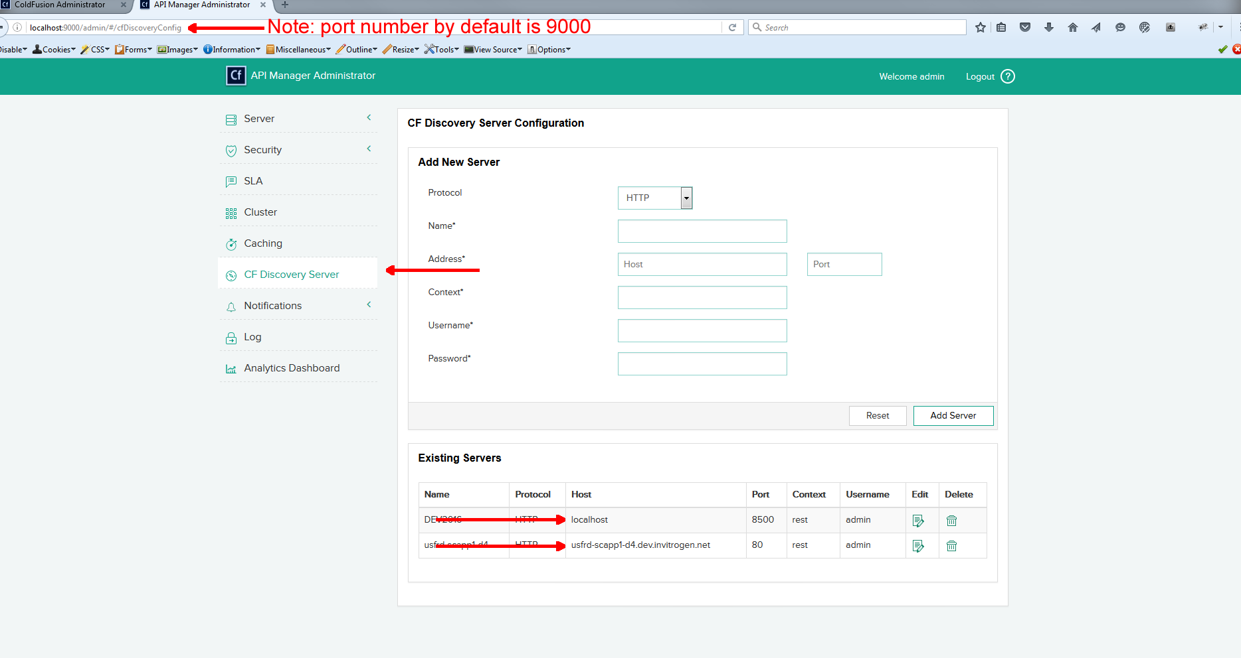
API Manager Administrator – Server Discovery
Notes:
Register CF Servers in API Manager Admin

Slide 28
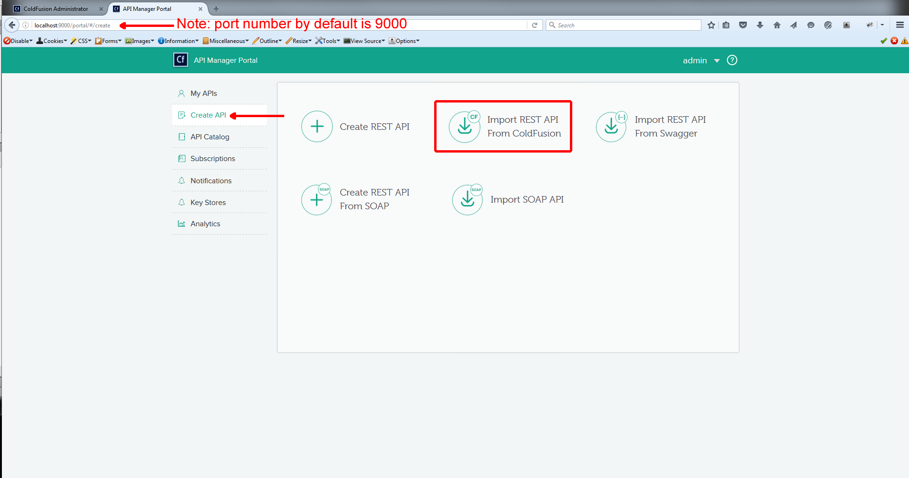
Create API - Import REST API From ColdFusion

Slide 29
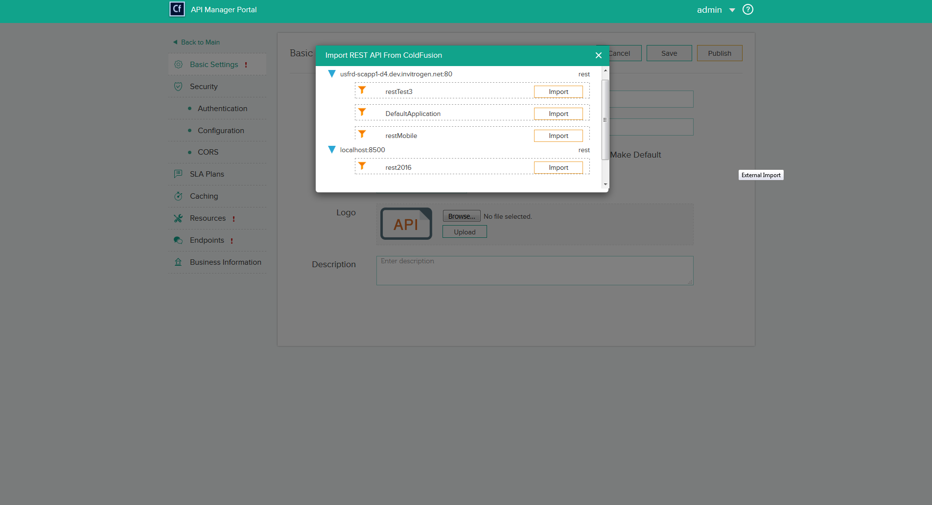
Create API - Select RESTful Service to Import
Notes:
Displays registered servers from API Admin. If multiple REST list will display and you select Import for one you want to import

Slide 30
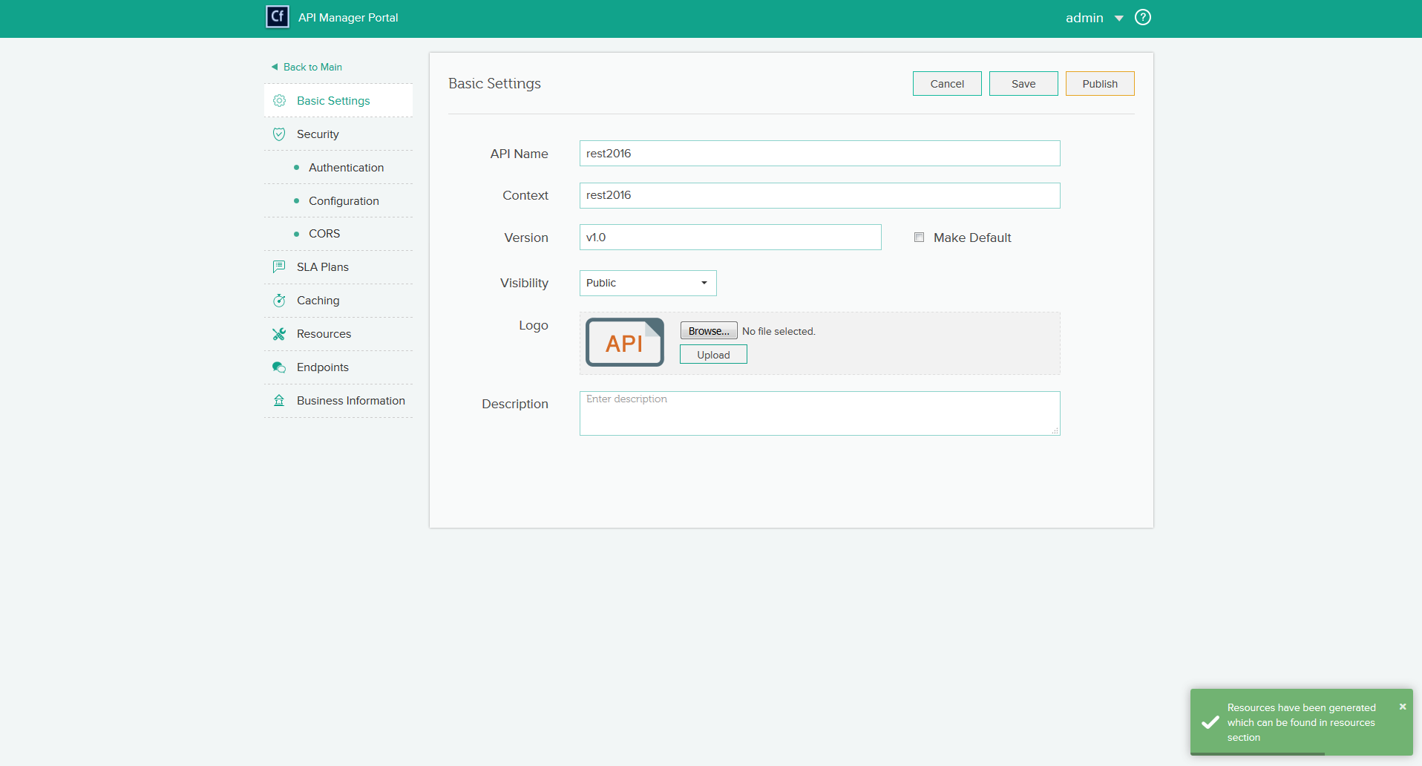
Create API - REST Import Complete
Notes:
Show import complete

Slide 31
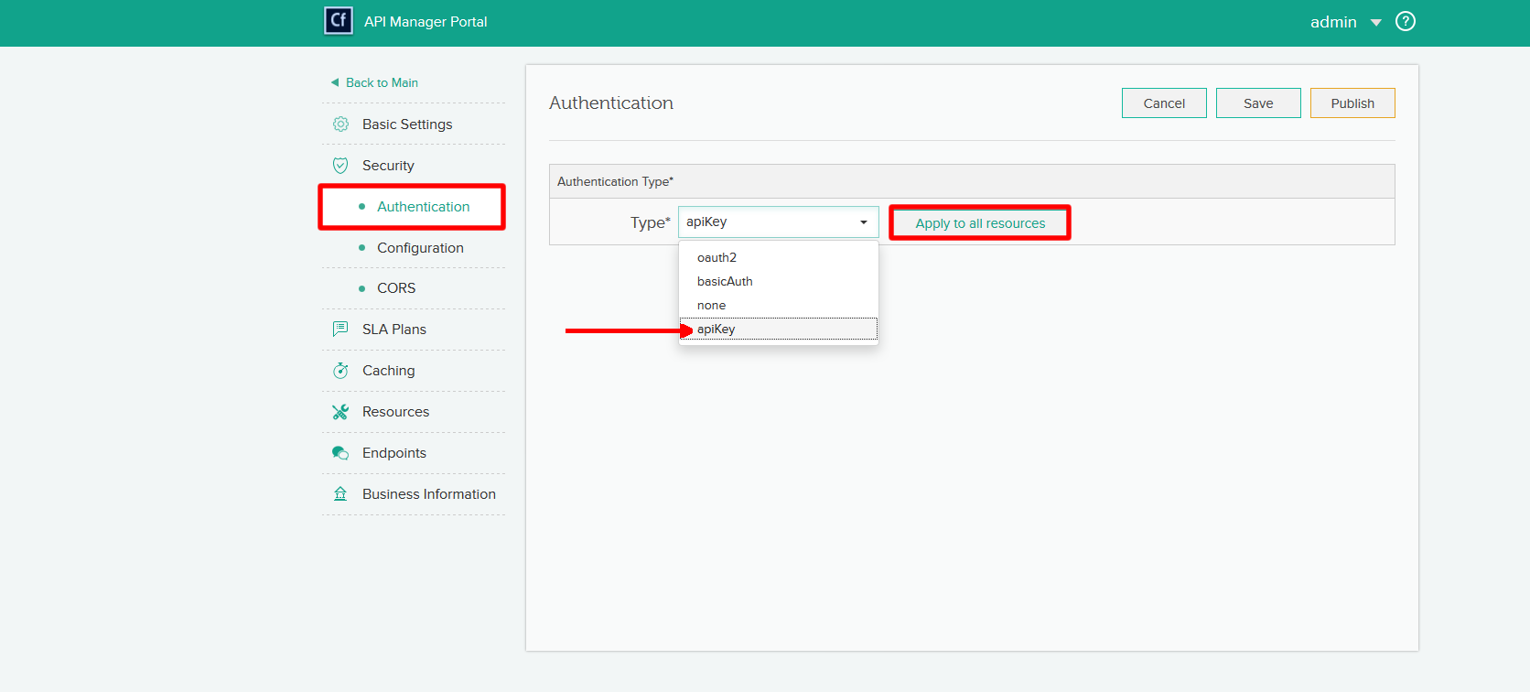
Create API - Apply Authentication
Notes:
Oauth2 –
BasicAuth -
apiKey –
none

Slide 32
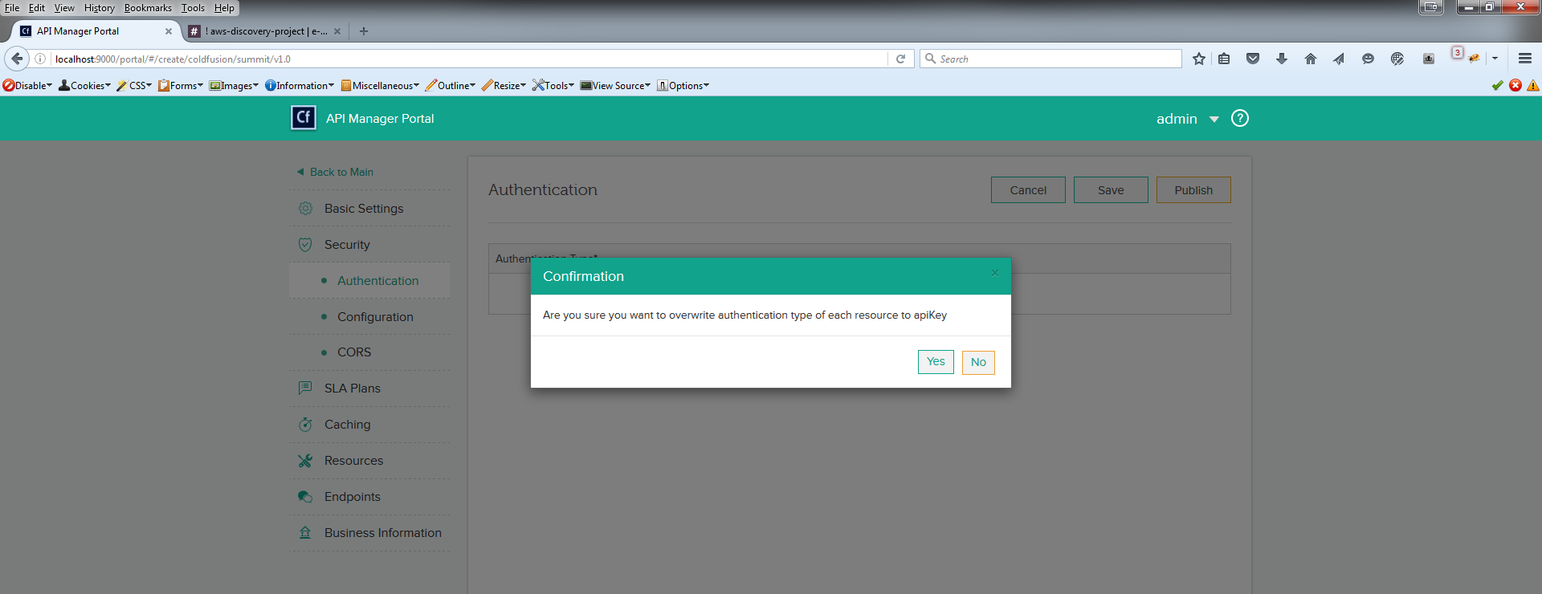
Create API - Confirm Authentication

Slide 33
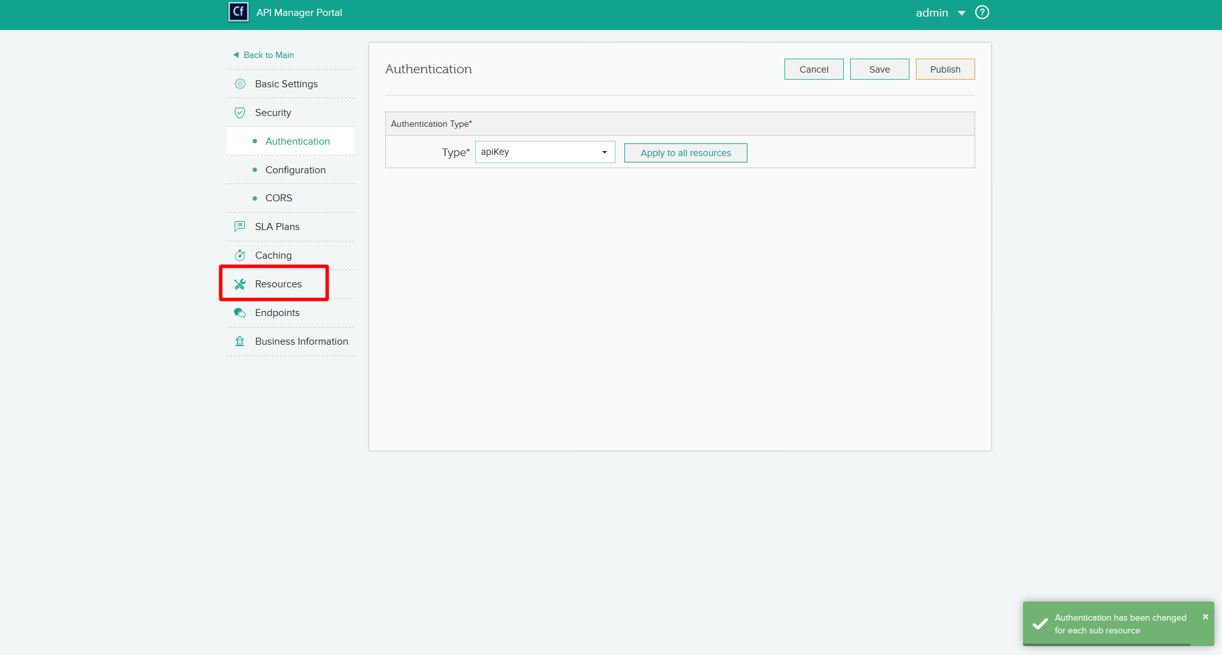
Create API – Select Resources

Slide 34
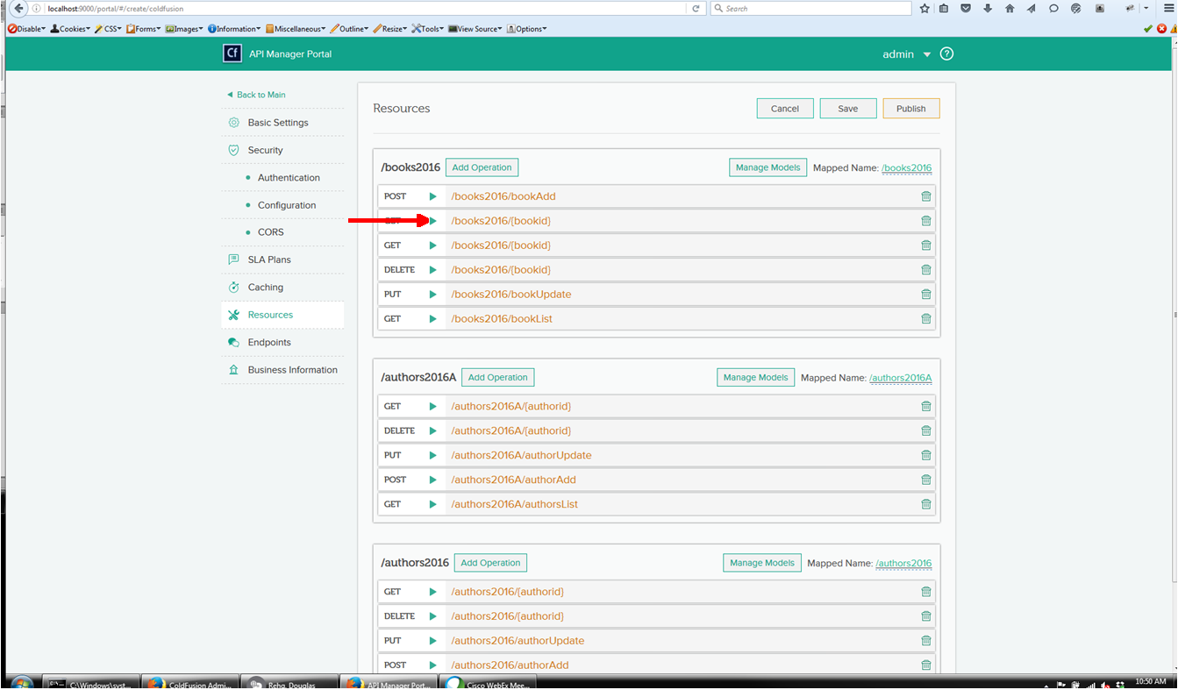
Create API – Select Get

Slide 35
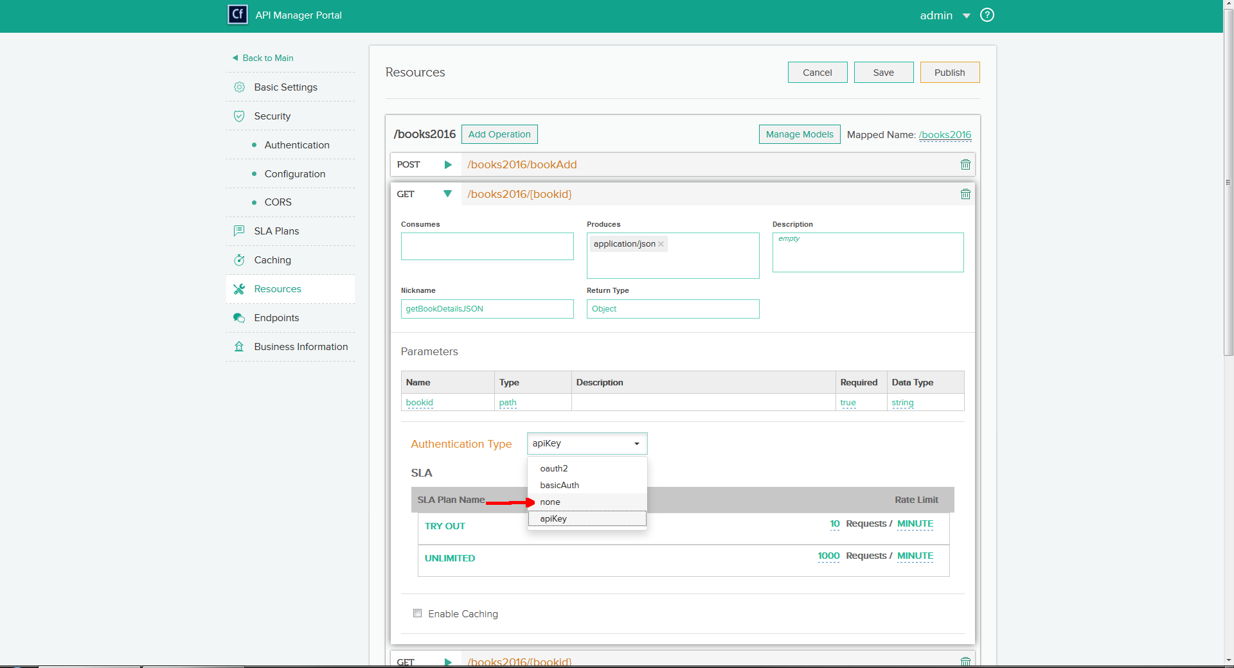
Set Authentication To “None”

Slide 36
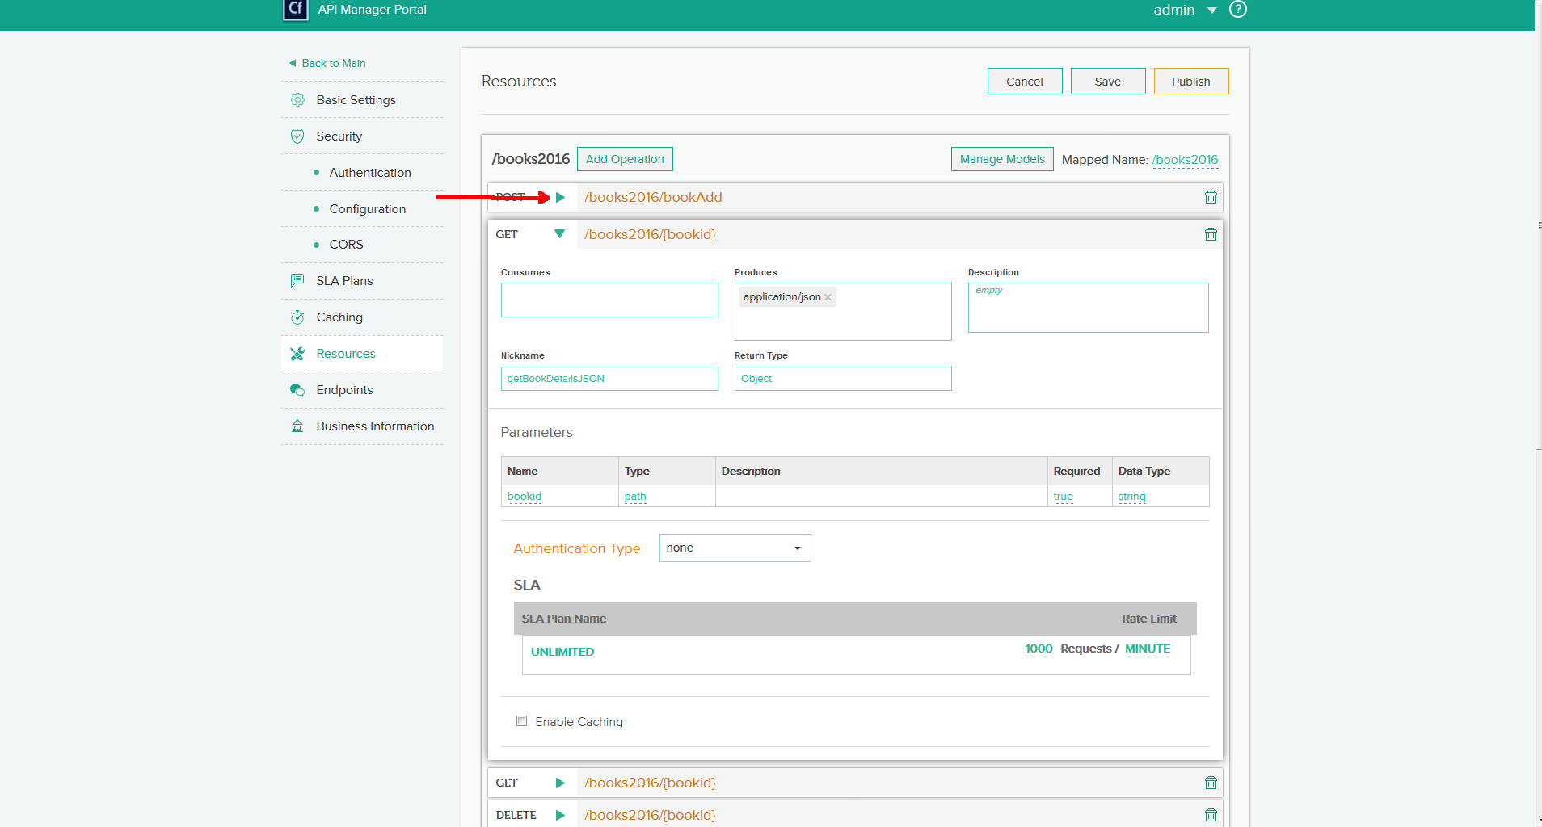
Create API – Select Post

Slide 37
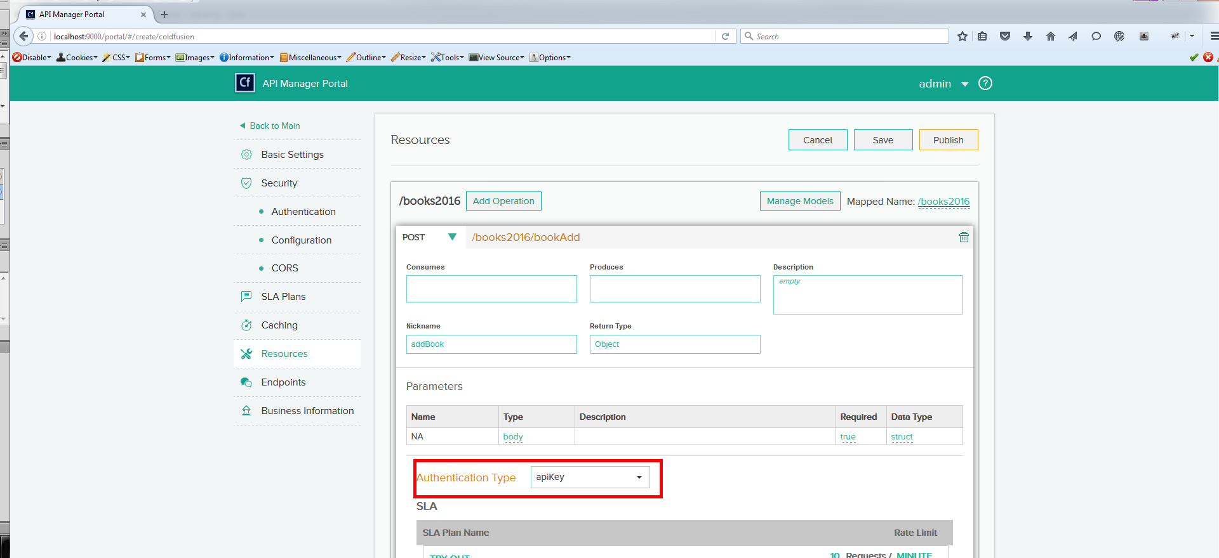
Create API – Confirm Authentication

Slide 38
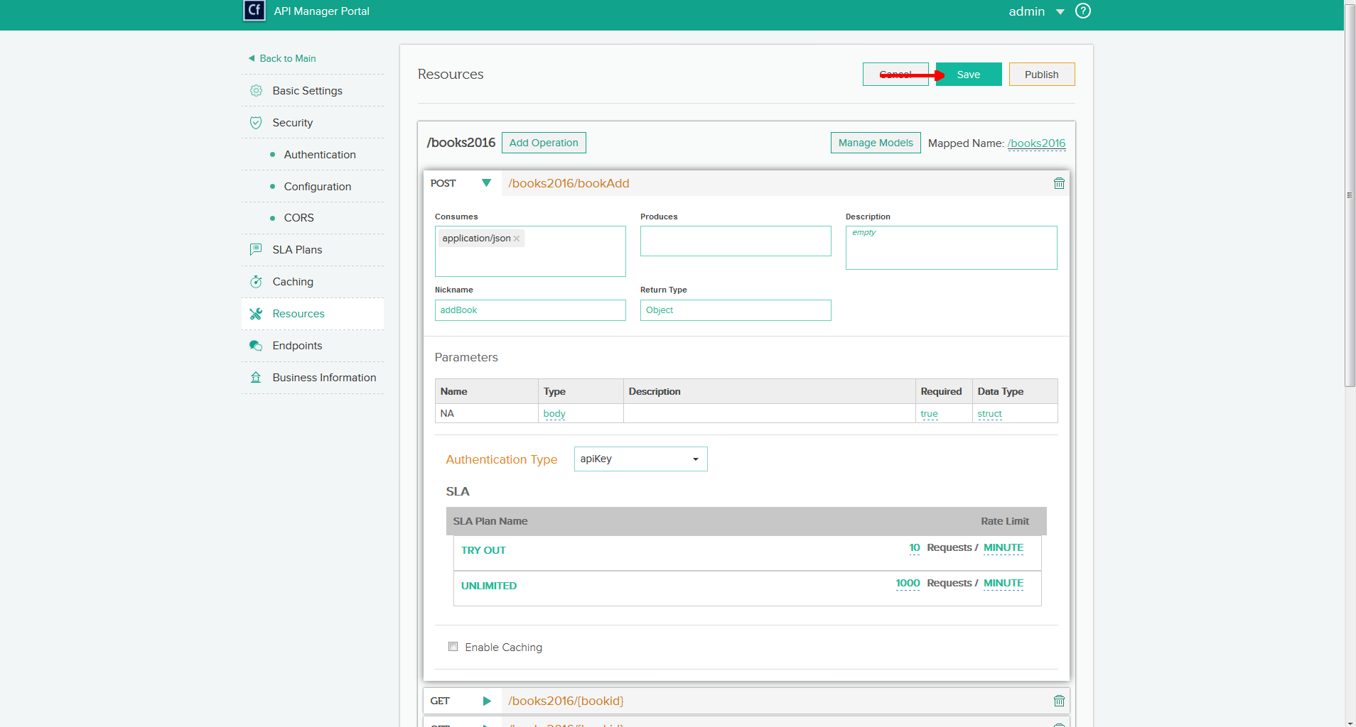
Create API – Save Changes

Slide 39
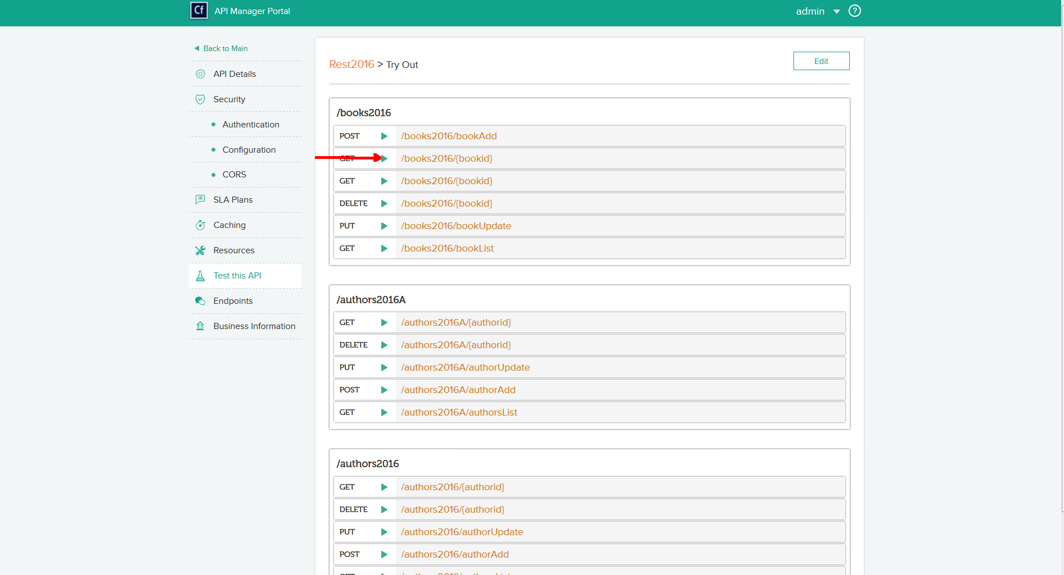
Test API - Get

Slide 40
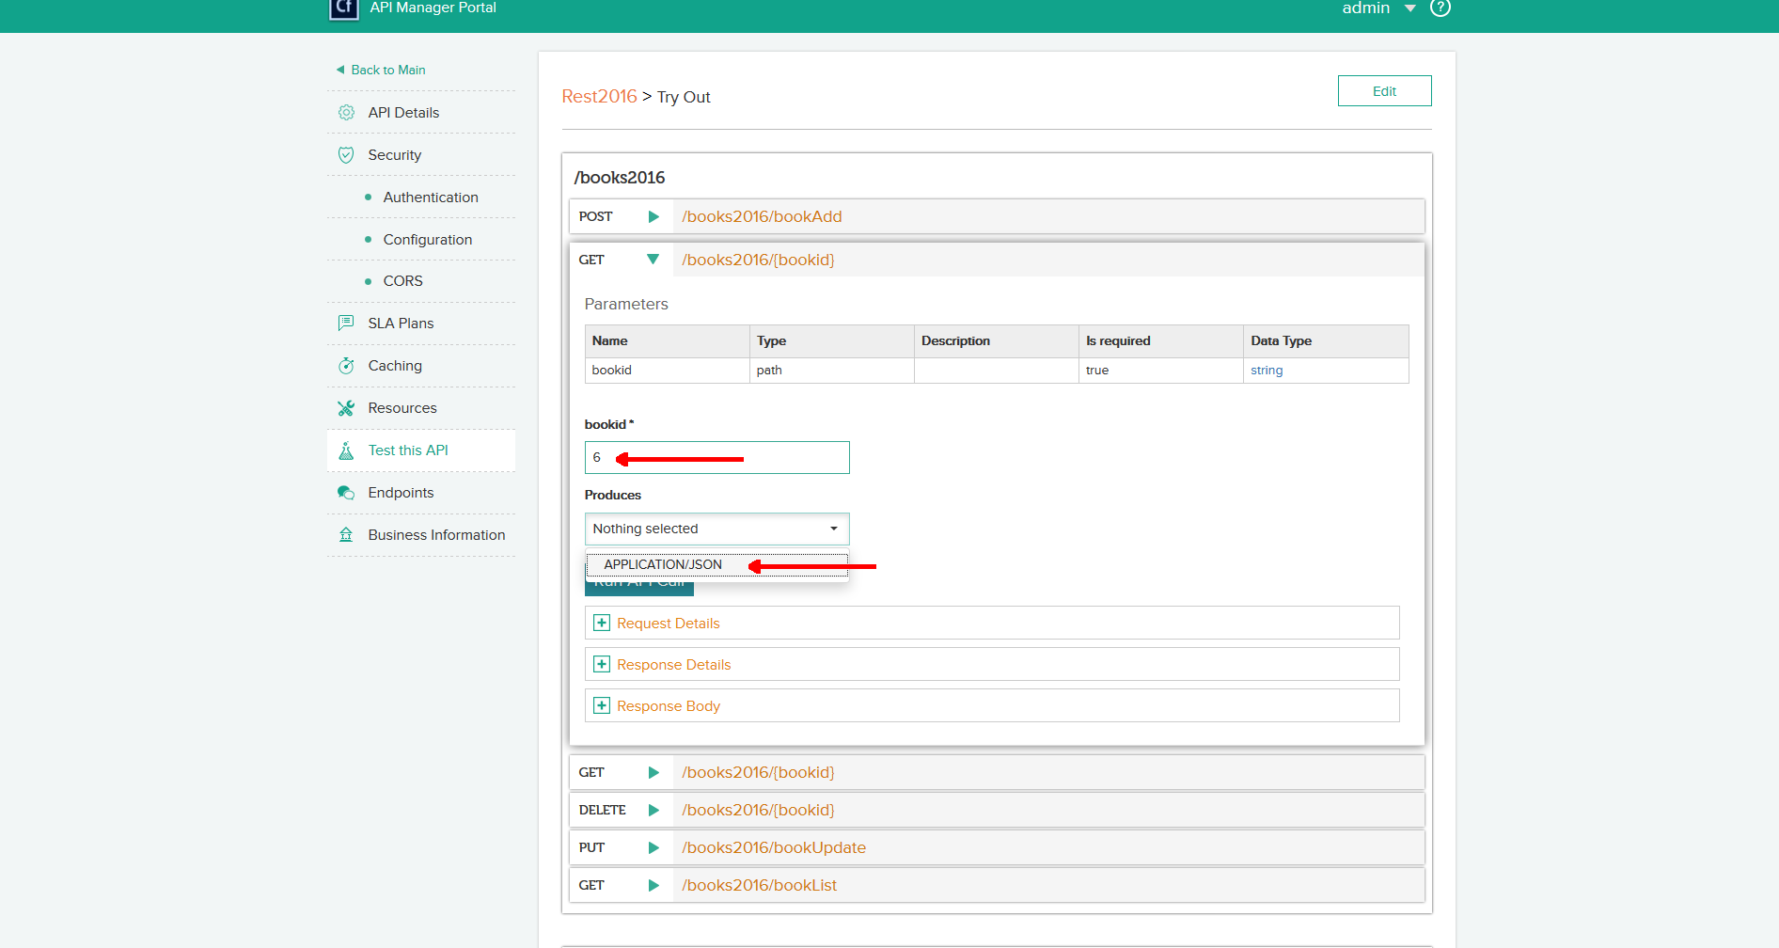
Test API - Get

Slide 41
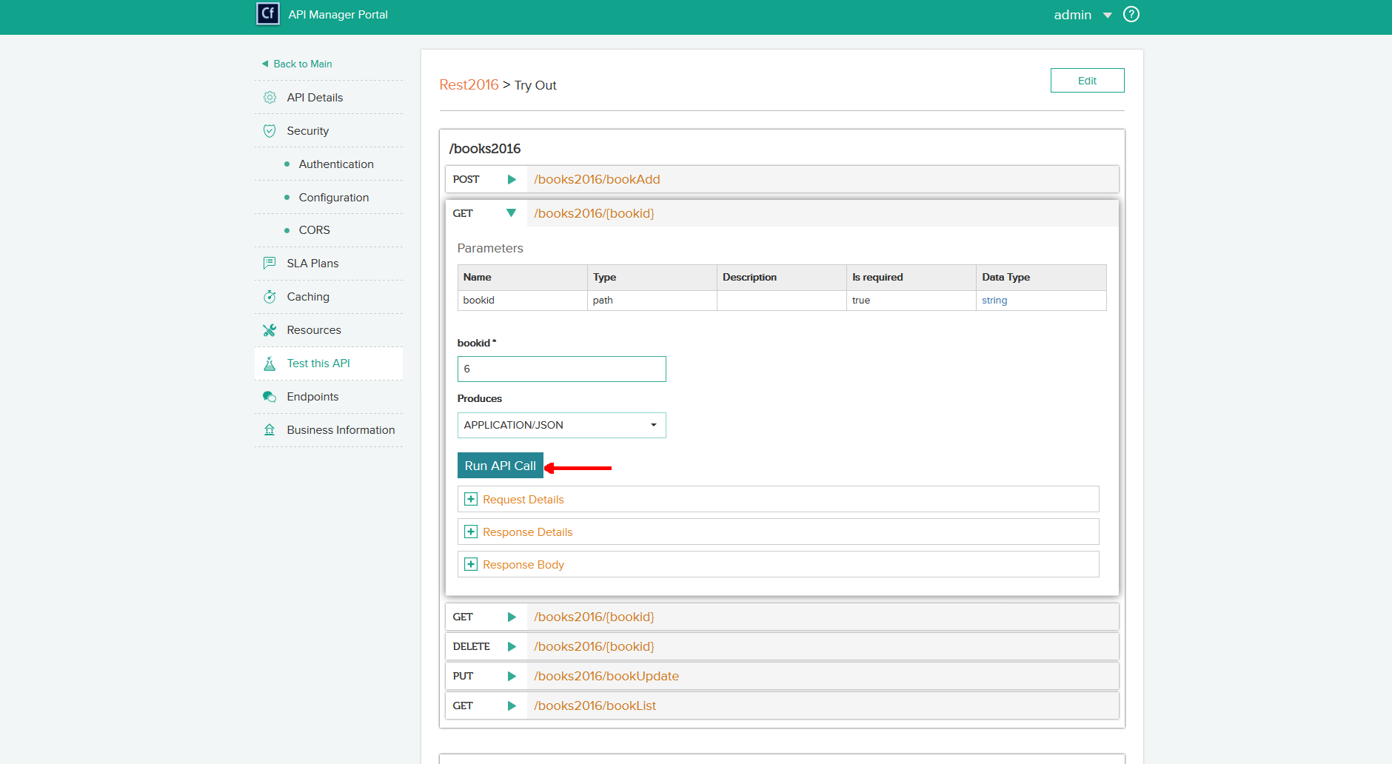
Test API - Get

Slide 42
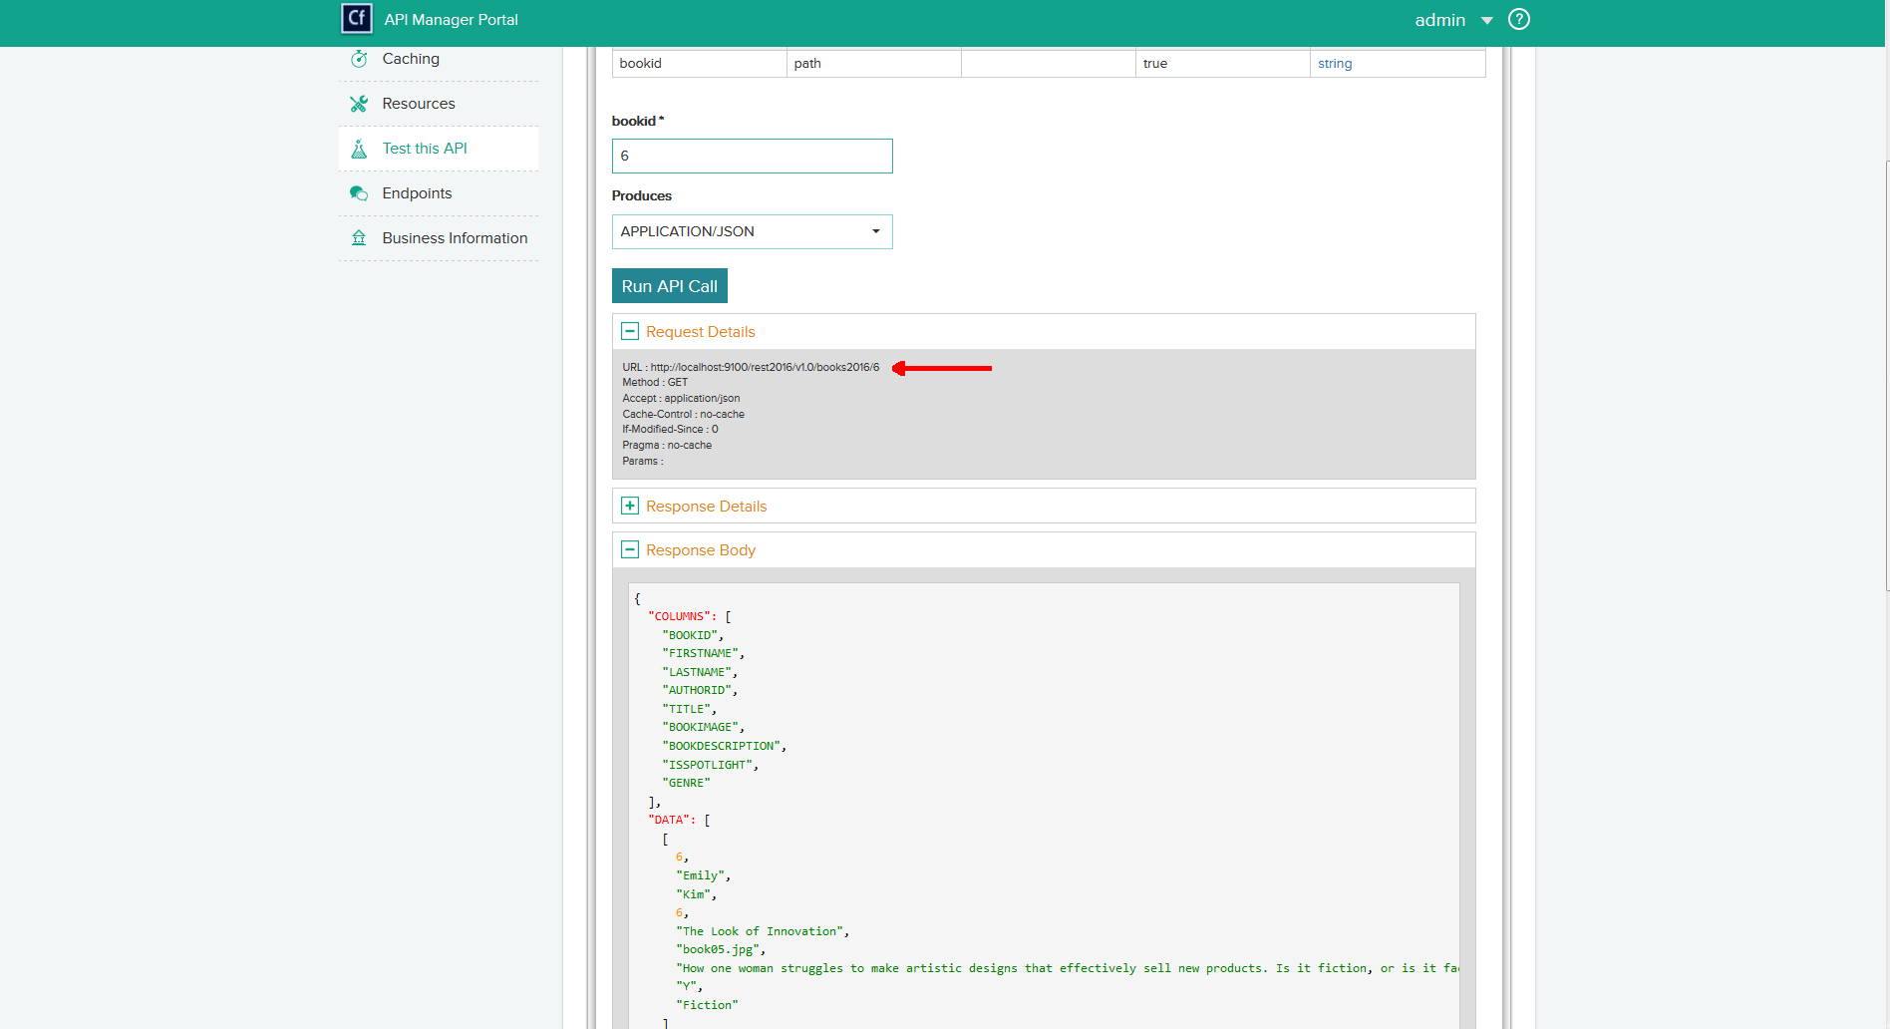
Test API - Get

Slide 43
Compare Code - Get
<cffunction name="getBookDetails" access="remote" httpmethod="GET" returntype="any" restpath="{bookid}" produces="application/json, application/xml">
<cfargument name="bookid" required="true" restargsource="Path" type="string">
<cfinclude template="inc_tracking.cfm">
<cfquery name="qBookDetails" datasource="#request.readDSN#">
select b.bookid, a.firstname, a.lastname, a.authorid, b.title, b.bookimage, b.bookdescription, b.isspotlight, b.genre
from app.books b, app.authors a
where a.authorid = b.authorid
and b.bookid = #arguments.bookid#
</cfquery>
<cfset temp = restThrow(throw="false", errorCode="200", message="OK", detail="Action completed successfully.", data="#serializeJSON(insertResults)#", sourcename="#getfunctioncalledname()#")>
<cfreturn qBookDetails>
</cffunction>

Slide 44
Compare Code – Call Get
<cfhttp url="http://localhost:9100/rest2016/v1.0/books2016/24" result="restResult" method="get“>
<cfhttpparam type="header" name="Accept" value="application/json" />
</cfhttp>
<cfdump var="#restResult#">
<cfhttp url="http://localhost:8500/rest/rest2016/books2016/24/.xml" result="restResult2" method="get">
</cfhttp>
<cfdump var="#restResult2#">

Slide 45
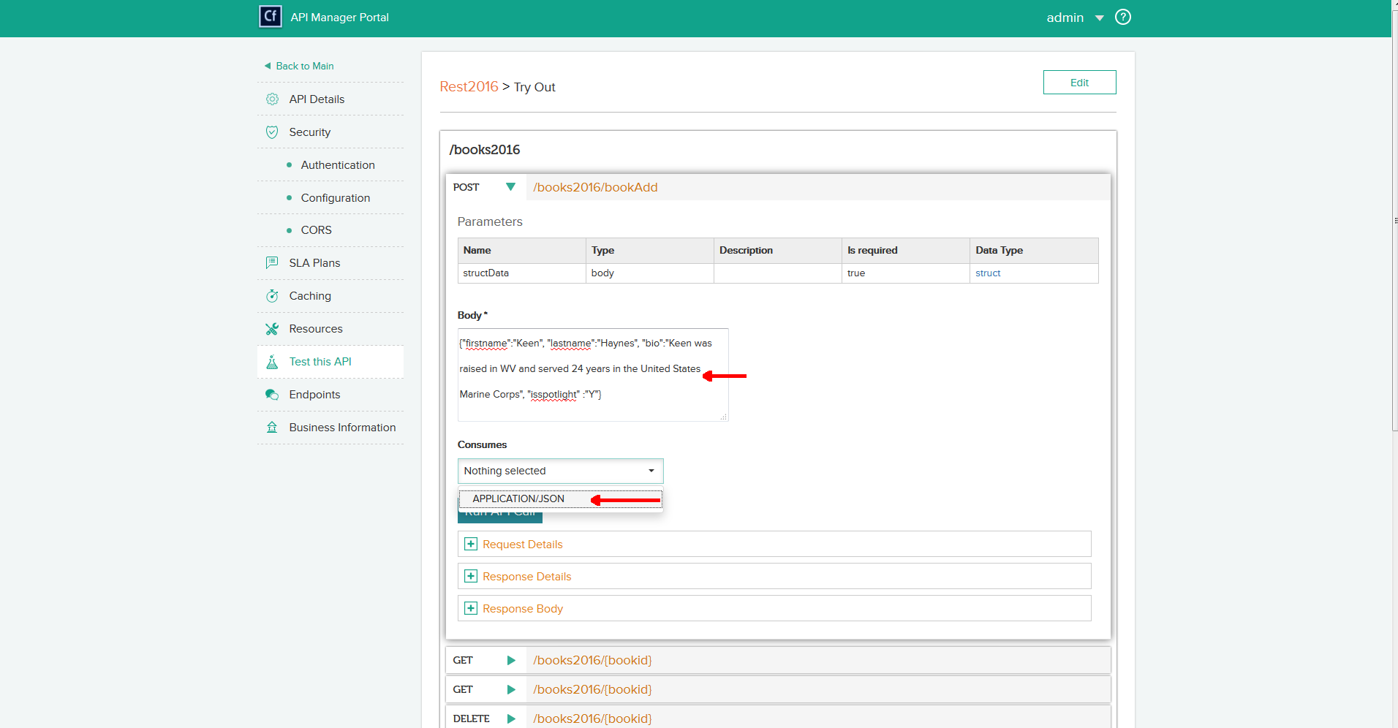
Test API - Post

Slide 46
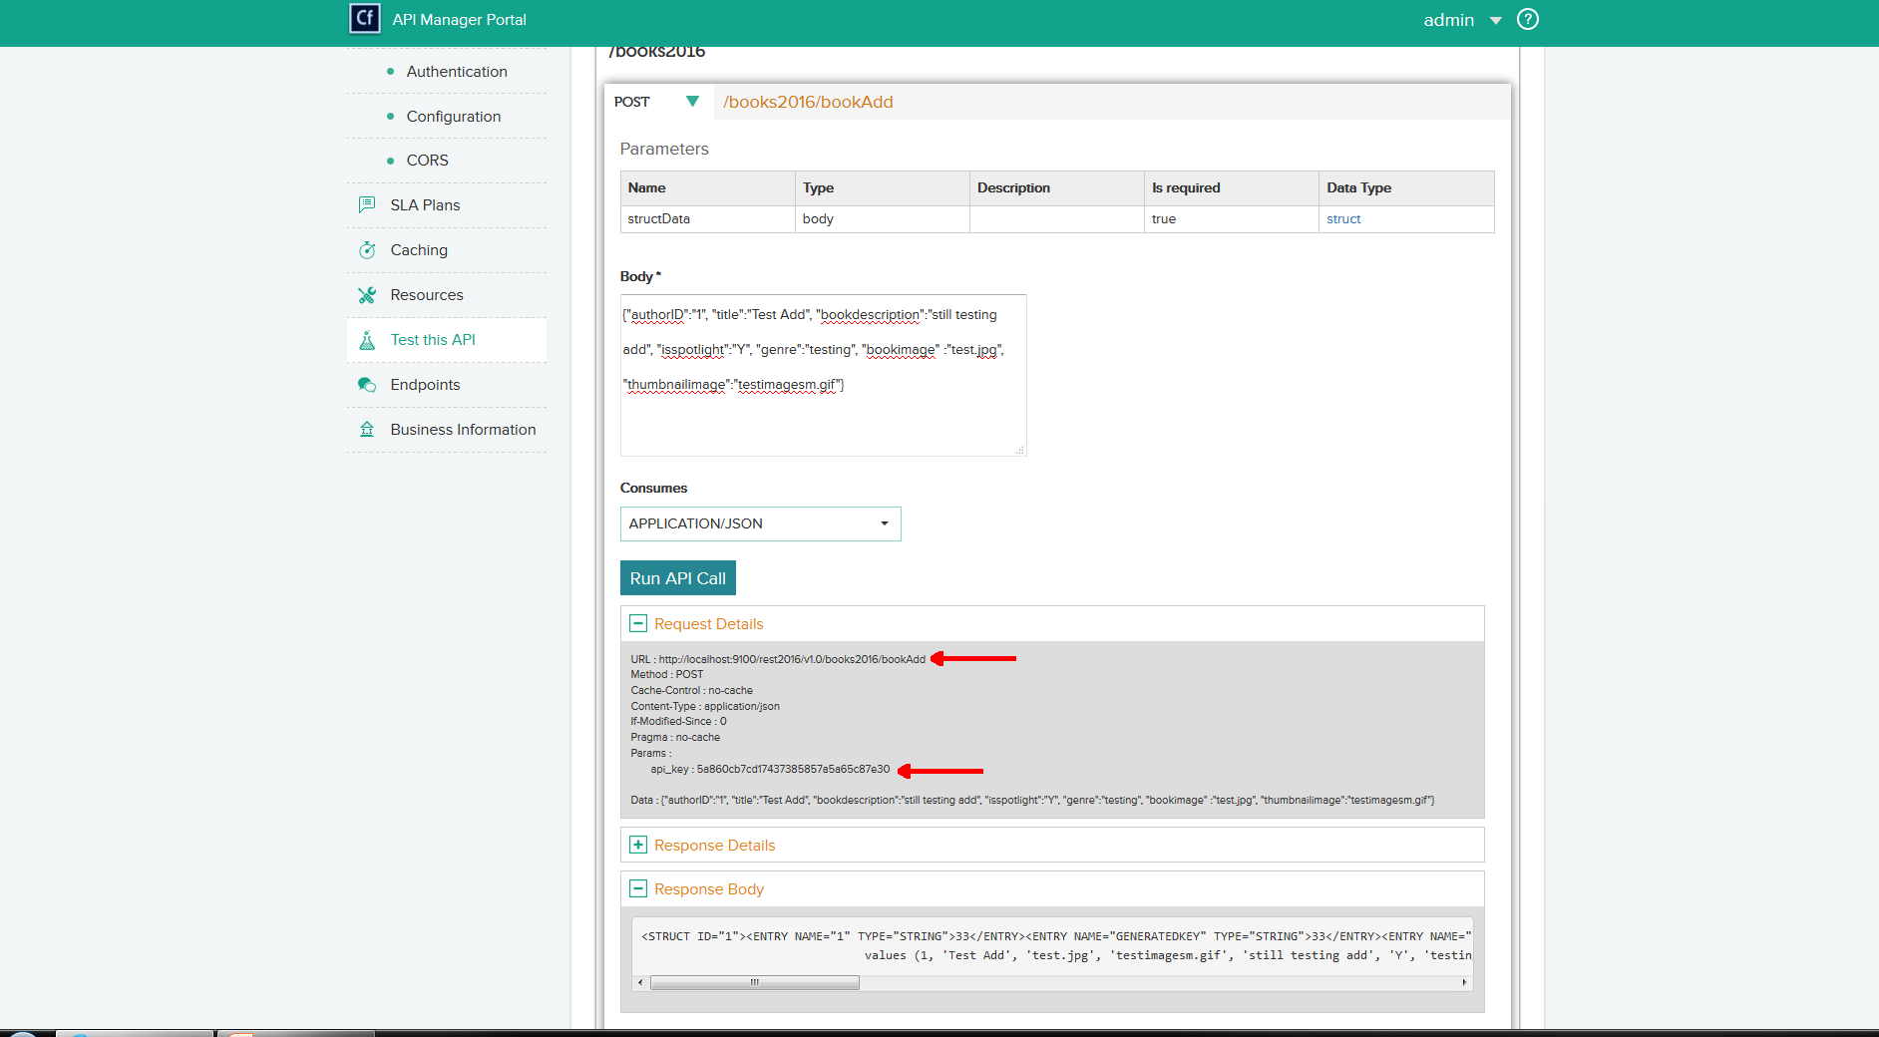
Test API - Post

Slide 47
Compare Code
<cffunction name="addBook" access="remote" httpmethod="POST" returntype="any" restpath="bookAdd">
<cfargument name="structData" type="struct" required="true" >
<cfinclude template="inc_tracking.cfm">
<cfinclude template="inc_auth.cfm">
<cfquery name="qAddBook" datasource="#request.readDSN#" result="insertResults">
insert into app.books (authorid, title, bookimage,thumbnailimage, bookdescription, isspotlight, genre)
values (#structData.authorid#, '#trim(structData.title)#', '#trim(structData.bookimage)#', '#trim(structData.thumbnailimage)#', '#trim(structData.bookdescription)#', '#structData.isspotlight#', '#trim(structData.genre)#')
</cfquery>
<cfset temp = restThrow(throw="false", errorCode="200", message="OK", detail="Action completed successfully.", data="#serializeJSON(insertResults)#", sourcename="#getfunctioncalledname()#")>
<cfreturn insertResults>
</cffunction>

Slide 48
Compare Code
<cfset variables.jsonStr = {authorID=1, title="Test Add", bookdescription="sstill testing add", isspotlight="Y", genre="testing", bookimage ="test.jpg", thumbnailimage="testimagesm.gif"}>
<cfset variables.dataString = SerializeJSON(variables.jsonStr)>
<cfhttp url="http://localhost:9100/rest2016/v1.0/books2016/bookAdd" result="restResult" method="post">
<cfhttpparam TYPE="Header"
name="content-type"
value="application/JSON">
<cfhttpparam TYPE="header"
name="api_key" value="5a860cb7cd17437385857a5a65c87e30">
<cfhttpparam TYPE="Body"
name="structData"
value="#variables.dataString#">
</cfhttp>
<cfdump var="#restResult#">

Slide 49
Compare Code
<cffunction name="addAuthor" access="remote" httpmethod="POST" returntype="any" restpath="authorAdd">
<cfargument name="firstname" required="true" restargsource="form" type="string">
<cfargument name="lastname" required="true" restargsource="form" type="string">
<cfargument name="isspotlight" required="false" default="N" restargsource="form" type="string">
<cfargument name="bio" required="false" default="" restargsource="form" type="string">
<cfquery name="qAddAuthor" datasource="#request.readDSN#" result="insertResults">
insert into app.authors (firstname, lastname,bio,isspotlight)
values ('#trim(arguments.firstname)#', '#trim(arguments.lastname)#', '#trim(arguments.bio)#', '#arguments.isspotlight#')
</cfquery>
<cfreturn insertResults>
</cffunction>

Slide 50
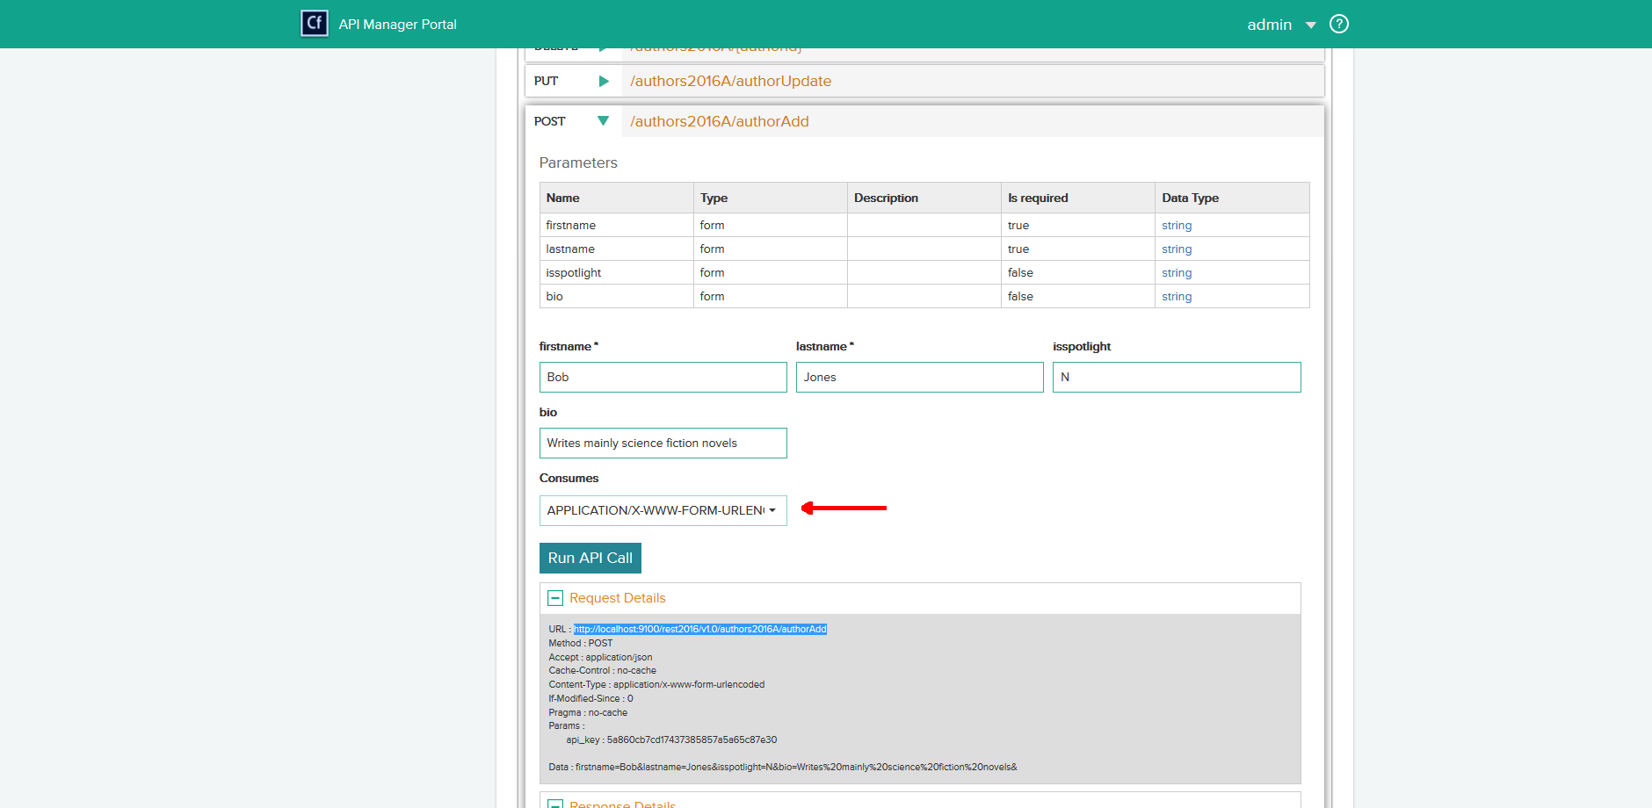
Test API

Slide 51
Compare Code
<cfhttp url="http://localhost:9100/rest2016/v1.0/authors2016A/authorAdd" result="restResult" method="post">
<cfhttpparam TYPE="Header" name="content-type" value="application/x-www-form-urlencoded">
<cfhttpparam TYPE="header" name="api_key" value="5a860cb7cd17437385857a5a65c87e30">
<cfhttpparam TYPE="FormField" name="firstname" value="Keen">
<cfhttpparam TYPE="FormField" name="lastname" value="Haynes">
<cfhttpparam TYPE="FormField" name="isspotlight" value="Y">
<cfhttpparam TYPE="FormField" name="bio" value="A retired United States Marine, Keen grew up in West Virginia. When not coding he can be found riding his Harley">
</cfhttp>
<cfdump var="#restResult#">

Slide 52
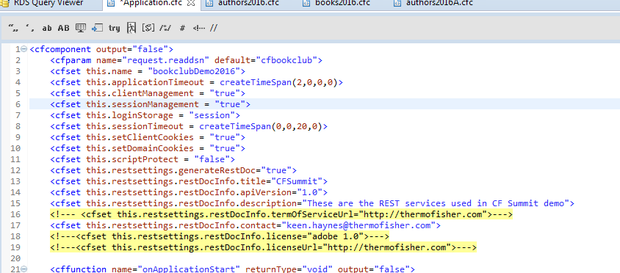
Generating Swagger Docs – Application.cfc
API Manager Help / Generating Swagger documents

Slide 53
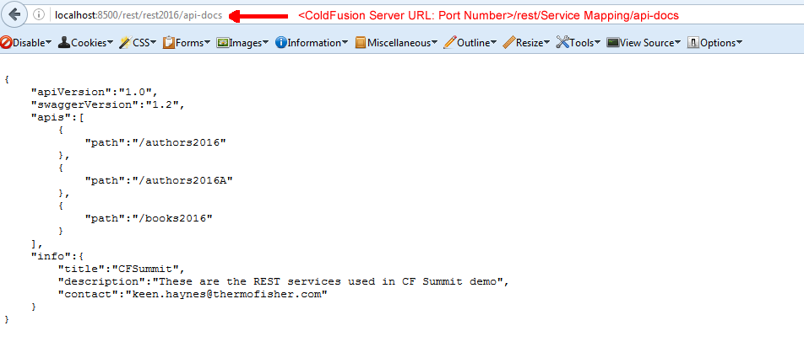
Generating Swagger Docs – Resource Listing

Slide 54
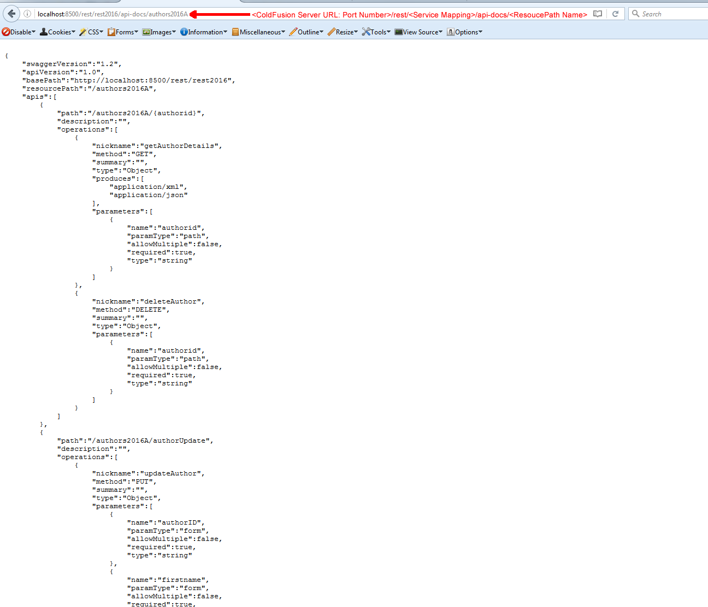
Generating Swagger Docs – API Declaration

Slide 55
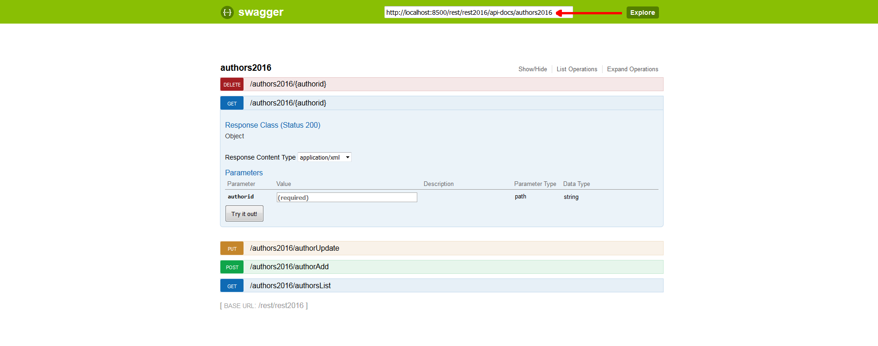
Swagger UI – Calling API Declaration

Slide 56
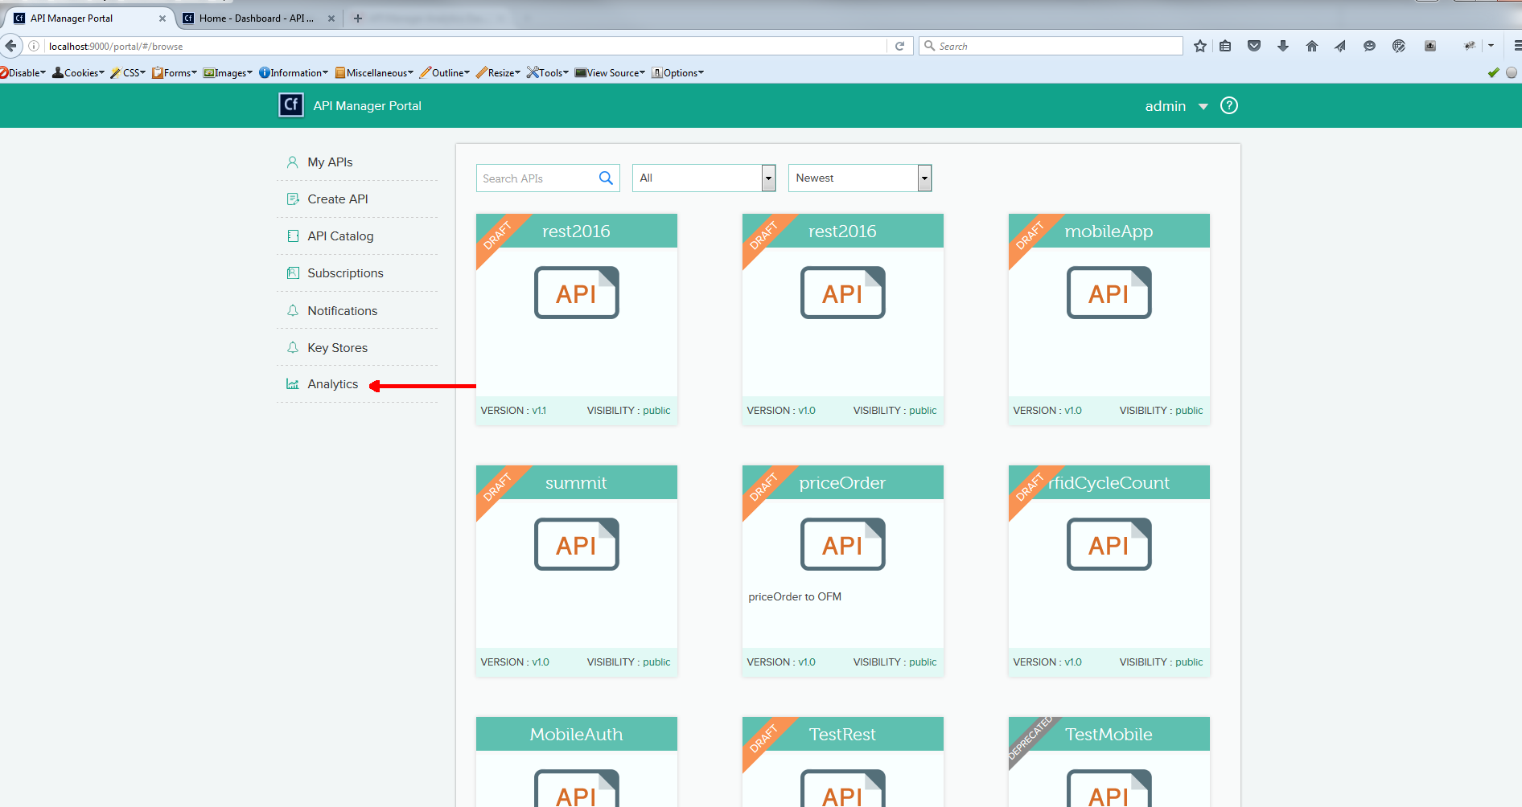
Analytics Dashboard

Slide 57
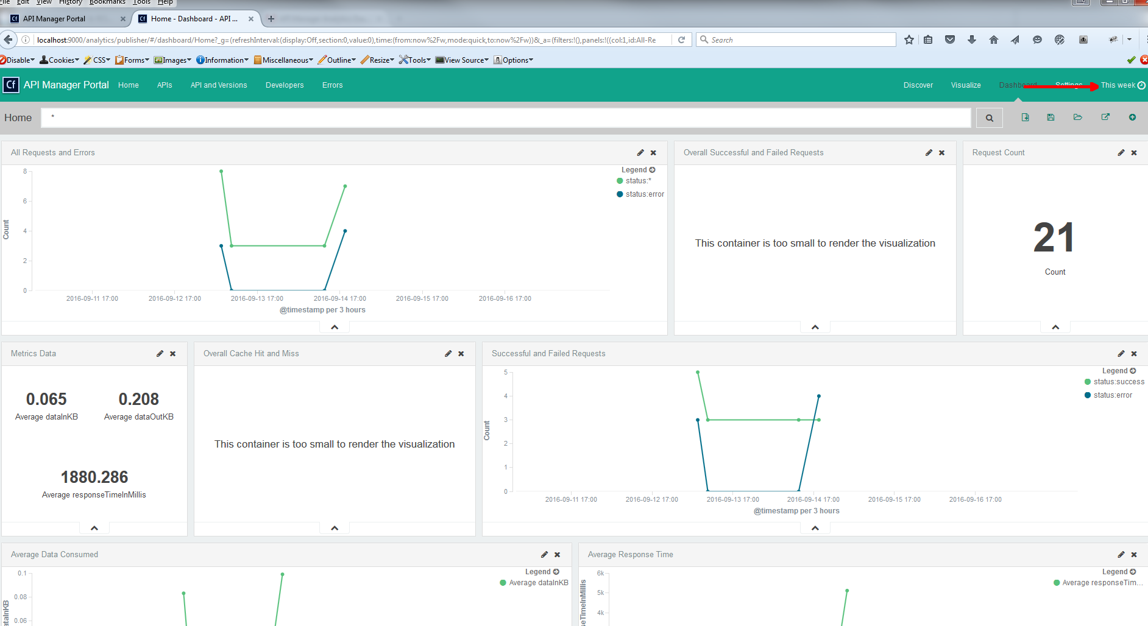
Analytics Dashboard - Home

Slide 58
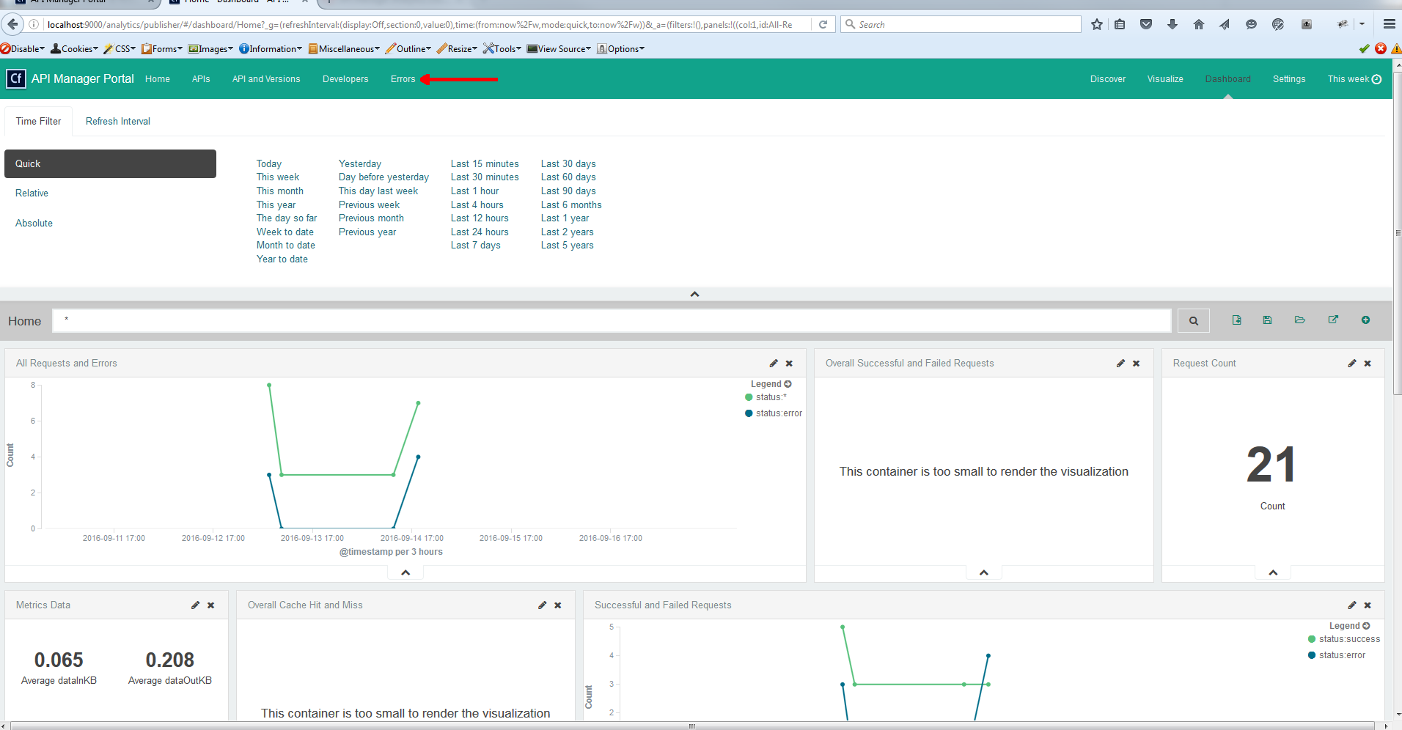
Analytics Dashboard – Setting Time Frame

Slide 59
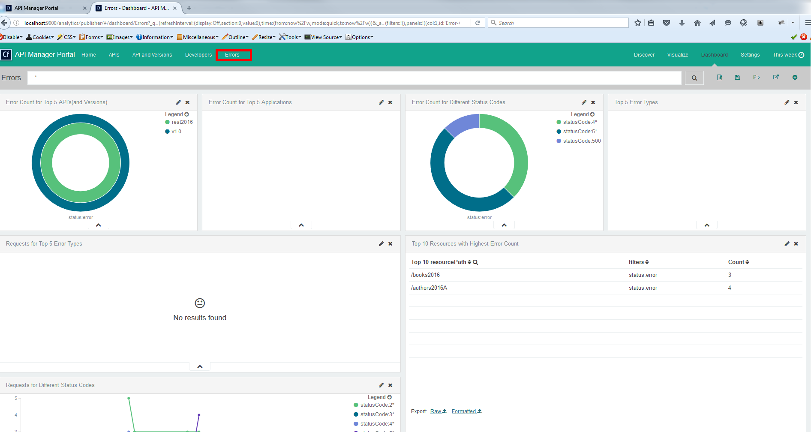
Analytics Dashboard - Errors

Slide 60
Helpful Links
REST RESOURCES
Getting started with RESTful web services in ColdFusion
REST Web Services In ColdFusion
Generating Swagger Docs
Swagger Docs CFML
Enable CORS Support
Getting CORS To Work With Apache
SOFTWARE
Adobe ColdFusion
SoapUI
Postman
Boomerang
Swagger UI
API MANAGER RESOURCES
ColdFusion API Manager Overview
API Manager Features Summary
Adobe ColdFusion API Manager Administrator
Introduction to Adobe ColdFusion API Managerl
API Administrator Portal
API Manager-Metrics and Logging
API Manager Analytics Dashboard
API Manager Authentication Types

Slide 61
This Is The End
QUESTIONS?

