Slide 1
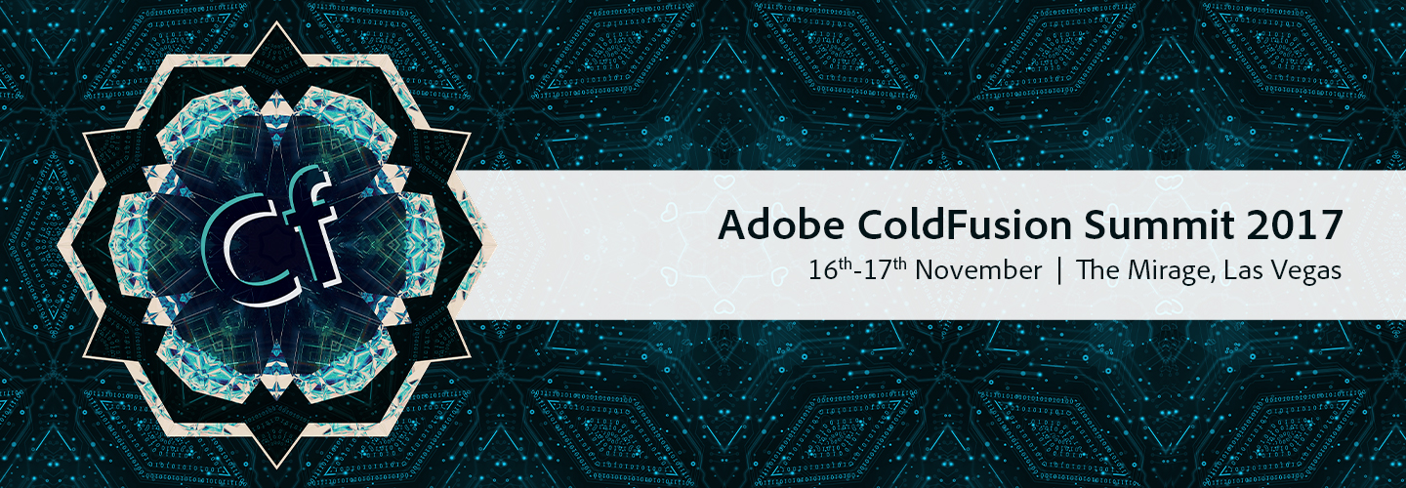
ColdFusion To The Cloud - A Real World Example

Slide 2

Supply Center Solutions
Notes:
This video showed our Supply Center RFID enclosures which are driven by ColdFusion. We also have enclosures that work with barcode scanners again ColdFusion based. These are just 2 examples of how ThermoFisher Scientific is utilizing ColdFusion to help our customers make the world heathier, cleaner and safer.

Slide 3
Keen Haynes
Senior ColdFusion Engineer
18+ years with ColdFusion
keen.haynes@thermofisher.com
Notes:
Good afternoon my name is Keen Haynes. I am a Senior ColdFusion Engineer with ThermoFisher Scientific. I have been working with ColdFusion for 18+ years which included at stint with Allaire and Macromedia as a Senior Consultant on the Consulting Service team. I am excited to be here and feel I have picked up some great information to see how the future of ColdFusion can continue to drive solutions at Thermo Fisher Scientific

Slide 4
What This Is – What It Is Not
This is not a “best practices” discussion but
an overview of how we accomplished the migration of our ColdFusion driven Supply Center application to AWS at ThermoFisher Scientific and some of the lessons we learned along the way.
Notes:
This is not a “best practices” discussion but an overview of how we accomplished the migration of our ColdFusion driven Supply Center application to AWS at ThermoFisher Scientific and some of the lessons we learned along the way.

Slide 5
Agenda
Why ThermoFisher Moved to the Cloud
Coldfusion Deployment Options (AMIs)
Jenkins
What is it
Deployment Pipelines
OpsWorks
AWS Console
What is it
S3 Buckets – creating and accessing
OpsWorks
Chef
Environment files (yaml)
Creating dynamic CF installs
API Manager in the Cloud
Questions
Notes:
Agenda Items

Slide 6

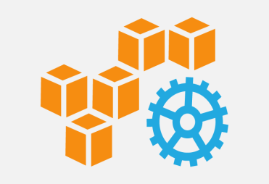

Why ThermoFisher Went to the Cloud
Productivity
Reliability and Scalability
Speed and Agility
Automate just everything – one step build, test and deploy
Provision new infrastructure in minutes compared to days to weeks
Enable automated, secure, consistent and repeatable website release process
99.99%+ availability for a single server
Scale up/down the websites on-demand to achieve cost savings
Support disaster recovery
Faster to Market – Roll out new features to the websites faster
Experiment often, iterate quickly and establish data-driven feedback from customers
Global expansion of IT capabilities – Build foundation of setting up local data centers (e.g., in China) cost effectively

Slide 7
What Is An AMI
An AMI is an encrypted Amazon Machine Image. It is a template that contains the software configuration (operating system, application server, and applications) required to launch your instance.
When you launch an EC2 (Amazon Elastic Compute Cloud) instance, you’re launching an instance of a previously created AMI. The idea here is that you launch some “base” instance to get started, install necessary software, configure, and otherwise get this instance into a shape that you’d want to deploy repeatedly. To do that, you’ll take the instance you previously created and create an image out of it. After you have an image, you can then launch multiple instances of it, thereby achieving the provisioning that brought you to AWS EC2 in the first place.

Slide 8
ColdFusion Deployment Options (AMIs)
AWS Maketplace: this is a service provided by AWS, and all AMIs here are verified by AWS. It is basically used for software vendors to sell their products through AWS. The customers will be billed by AWS only, but then AWS will pay the AMI owner in return.
Community AMIs: Whenever you create an AMI, you can add permissions to it to make it public. In that case, it goes to "community AMIs". These are AMIs that comes from AWS users, and are not verified by AWS
Custom AMI – build your own (Be sure to confirm licensing models with Adobe)
Notes:
AWS Maketplace: this is a service provided by AWS, and all AMIs here are verified by AWS. It is basically used for software vendors to sell their products through AWS. The customers will be billed by AWS only, and AWS will pay the AMI owner in return.
Community AMIs: Whenever you create an AMI, you can add permissions to it to make it public. In that case, it goes to "community AMIs". These are AMIs that comes from AWS users, and are not verified by AWS
Custom AMI – while there are ColdFusion AMIs we opted to build our own mainly because we already had the licenses and did not want to pay for using a Market Place AMI

Slide 9
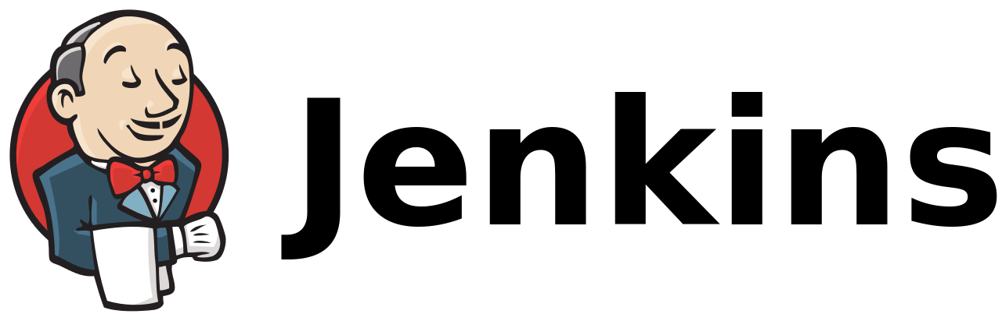
Jenkins
Allows for the continuous integration and continuous delivery
of projects
It is an open source tool with great community support
It supports Python, Ruby, Java, Android, C/C++
It is built with Java and hence, it is portable to all the
major platforms.
It has 1000+ plugins to ease your work.
It is available on the AWS Marketplace
Notes:
Jenkins is a self-contained, open source automation server which can be used to automate all sorts of tasks such as building, testing, and deploying software.

Slide 10

Jenkins
Jenkins
    Infrastructure Pipeline
Package infrastructure templates (CloudFormation)
Package configuration scripts (Chef)
Publish packaged resources to AWS
Delete current Stack
Create / Recreate new Stack
Rerun (update) current Stack
Release Pipeline
Build and package application
Publish packaged resources to AWS
Perform automated tests
Deploy to existing infrastructure in target environment
Request approval from manual QA testing
Release to next environment
Notes:
A stack is a collection of AWS resources that you can manage as a single unit. A stack, for instance, can include all the resources required to run a web application, such as a web server, a database, and networking rules. In our case the stack contains a Windows server with ColdFusion and IIS enabled. Jenkins Pipeline (or simply "Pipeline" with a capital "P") is a suite of plugins which supports implementing and integrating continuous delivery into Jenkins. A continuous delivery pipeline is an automated expression of your process for getting software from version control right through to your users and customers. The deployment pipeline is responsible for the deployment of your ColdFusion code.

Slide 11
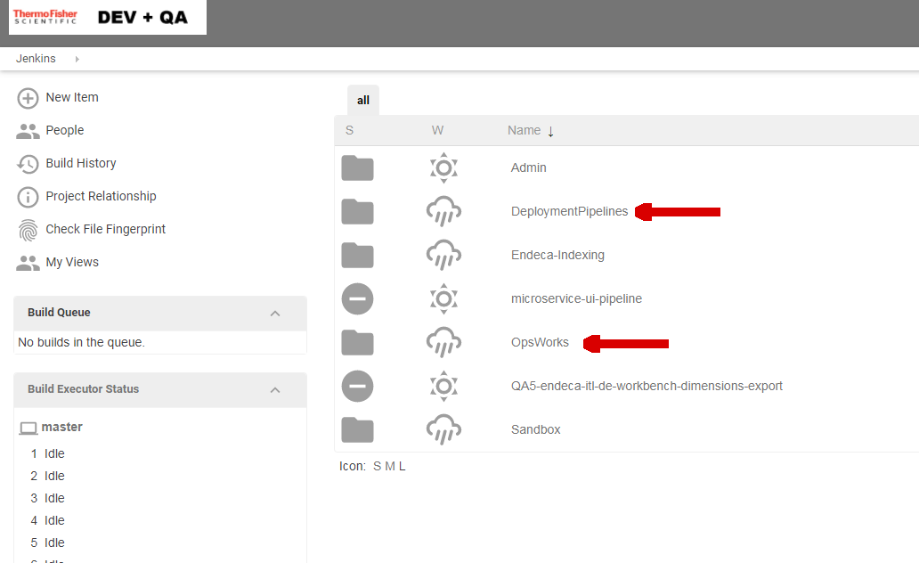
Jenkins
Notes:
Reflects links to Deployment Pipeline which is used for code deployment and OpsWork which supports recreate/rerun and delete of instances

Slide 12
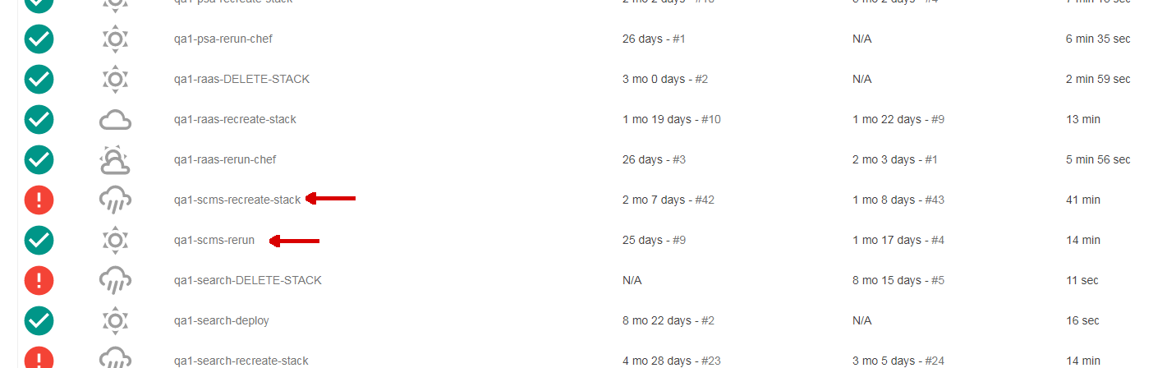
Jenkins – OpsWorks
Notes:
OpsWorks link to recreate and rerun with columns that display Last Success – Last Failure – Last Duration

Slide 13
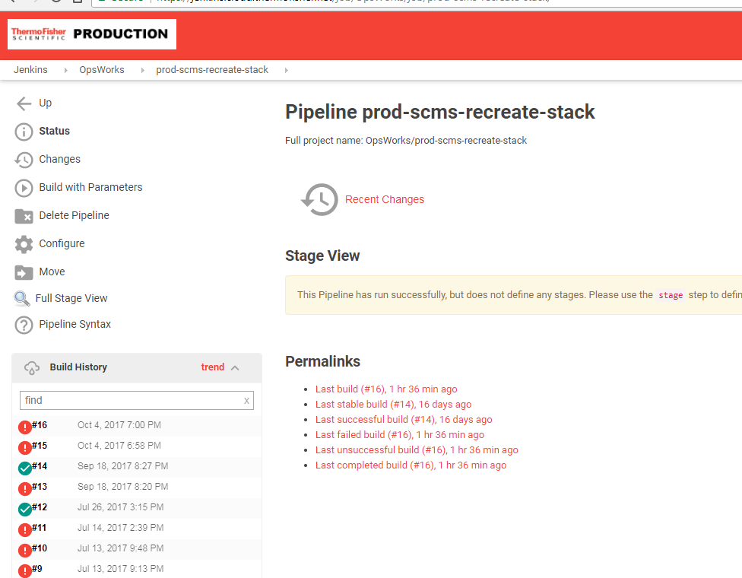
Jenkins - OpsWorks
Notes:
This is it the dash board for the prod-scms-recreation-stack…..this is where you are going to use Jenkins to create, recreate, rerun or delete your stack. Note how in the build history #16 which was the last run indicates a failure. Now lets go look at that same stack in the AWS Console

Slide 14
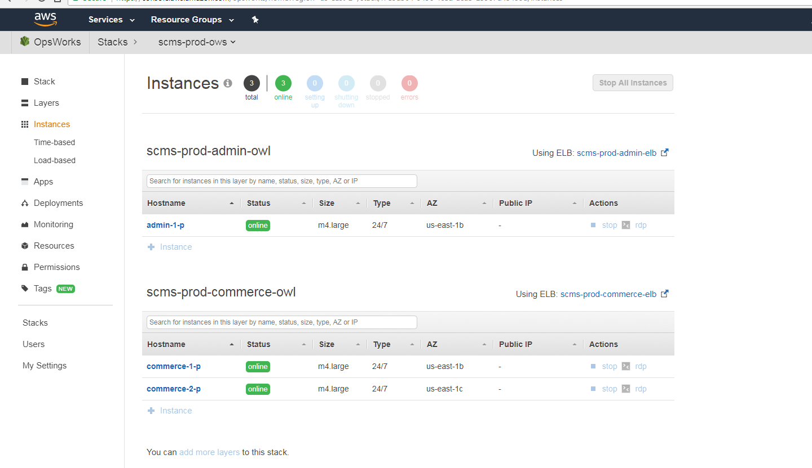
Jenkins – OpsWorks – Was It A Failure
Notes:
This is the same stack in OPSWorks on the AWS Console and clearly all 3 instances in the stack are online! This is an instance where a failure was not a failure. Jenkins was receiving a timeout message from AWS during the recreate process due to the amount of time Windows was taking to be created. In the AWS Console the status would actually go from “booting” to “start_failed” and then suddenly it would change to “running_setup” and then “online”. The only way we were able to determine if it was a true failure when it first occurred was if log files existed in the AWS Console.

Slide 15
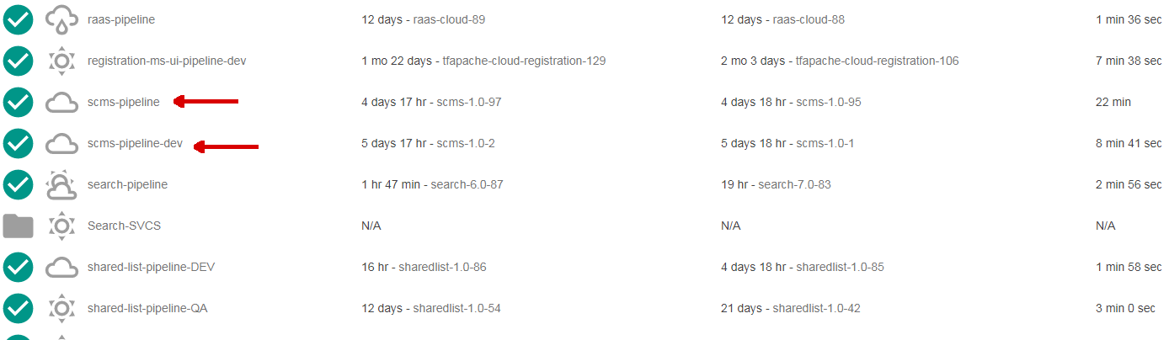
Jenkins – deployment pipeline
Notes:
Links to dev and qa deployment pipelines and again provides information related to the Last Success – Last Failure – Last Duration

Slide 16
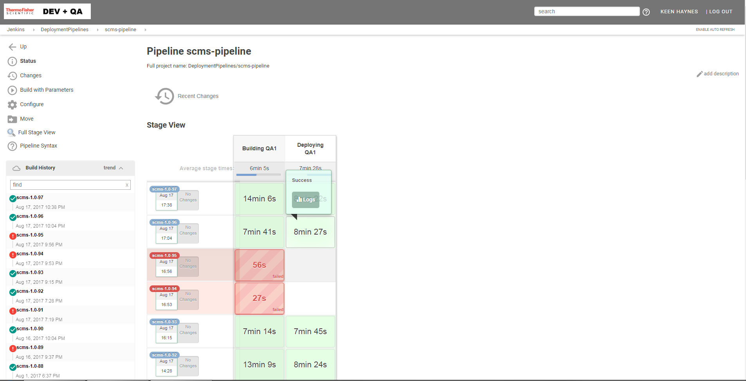
Jenkins scms-pipeline
Notes:
This is the layout of the pipeline dashboard – this is the interface we used to deploy our coldfusion code base. As you can see this is showing history for QA1. The section Building QA1 reflects the build of your deployment zip file (code) which is placed in a S3 bucket. The deploying section is for the download of zip from S3 bucket and unzip / deploy of code/ Notice that in the successful runs the log files can be accessed via the deploying section. For failures the log file is located in the failure section.

Slide 17
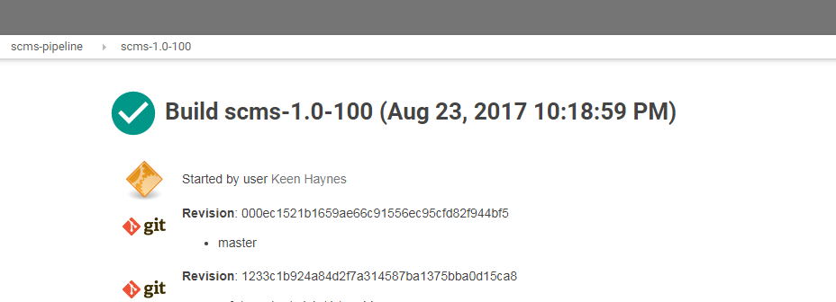
Jenkins scms-pipeline (console output)
When is a success really a failure?
[22:20:24] {/apps/jenkins/workspace/DeploymentPipelines/scms-pipeline@2/util/opsworks_util.py:593} INFO - DEPLOYING APP VERSION scms-1.0-100 WITH ROLLBACK TO VERSION 1 IF ERROR ENCOUNTERED
[22:22:47] {/apps/jenkins/workspace/DeploymentPipelines/scms-pipeline@2/util/opsworks_util.py:723} WARNING - ROLLING BACK FROM APP VERSION scms-1.0-100 TO PREVIOUS APP VERSION 1
[22:26:10] {/apps/jenkins/workspace/DeploymentPipelines/scms-pipeline@2/util/opsworks_util.py:725} WARNING - ROLLBACK COMPLETE
Notes:
When is a success really a failure? Pipeline dashboard was showing success while console output reflects rollback of code due to error.

Slide 18
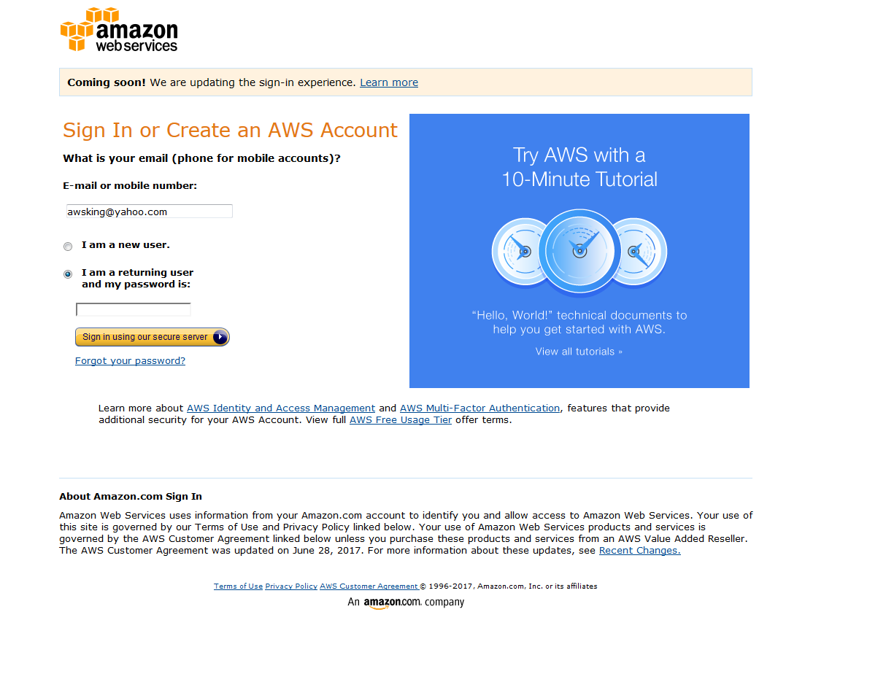
AWS Console
The AWS Management Console is a browser-based GUI for Amazon Web Services (AWS). Through the console, a customer can manage their cloud computing, cloud storage and other resources running on the Amazon Web Services infrastructure.
Notes:
AWS Console Login Screen The AWS Management Console is a browser-based GUI for Amazon Web Services (AWS). Through the console, a customer can manage their cloud computing, cloud storage and other resources running on the Amazon Web Services infrastructure.

Slide 19
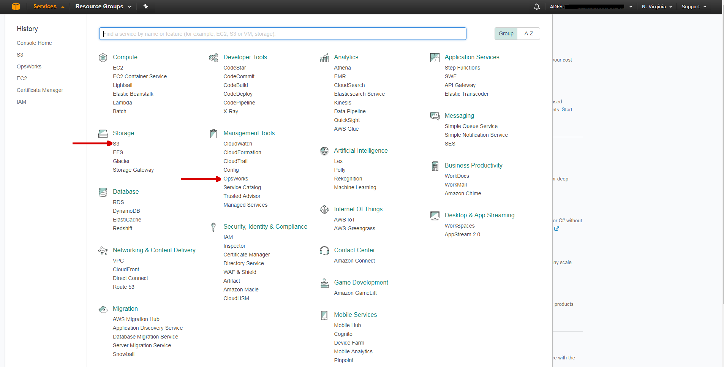
AWS Console
Notes:
This is the AWS dashboard displaying the Services that are available. Note the number of services – in this talk we will look at the S3 and OpsWorks services.

Slide 20
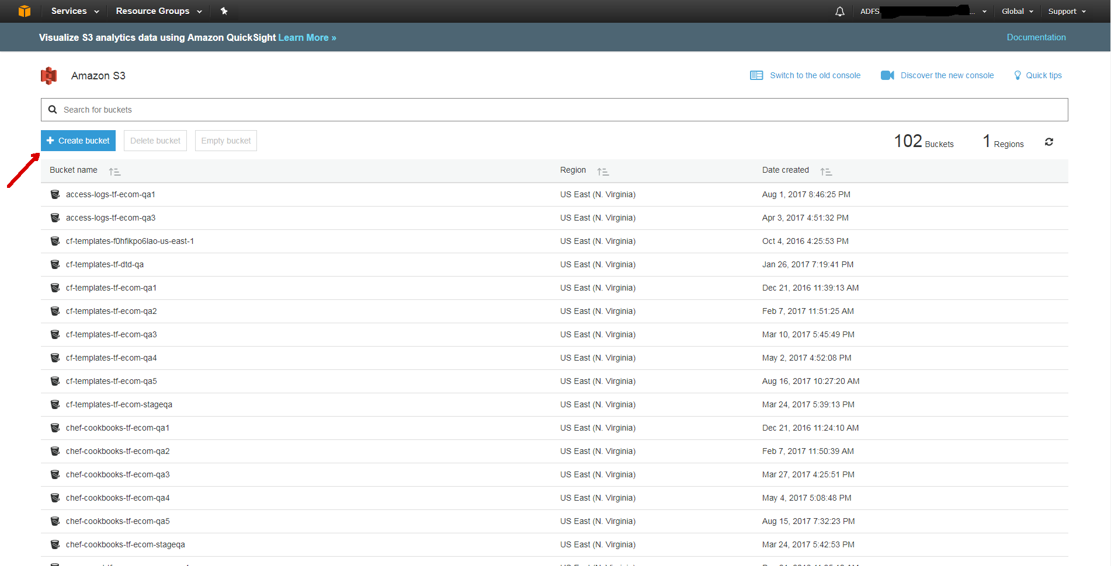
AWS Console – S3
Notes:
This is a partial list of all the S3 buckets that currently exist in our project. A bucket is a logical unit of storage in Amazon Web Services (AWS) object storage service, Simple Storage Solution S3. Buckets are used to store objects. In our situation we used the S3 buckets for a number of objects. First our deployment zip files are uploaded and stored in S3 buckets. Next we use are S3 buckets to store assets such as images that are then retrieved for use on our Supply Center customer home page. Let’s take a quick look at creating an S3 bucket

Slide 21
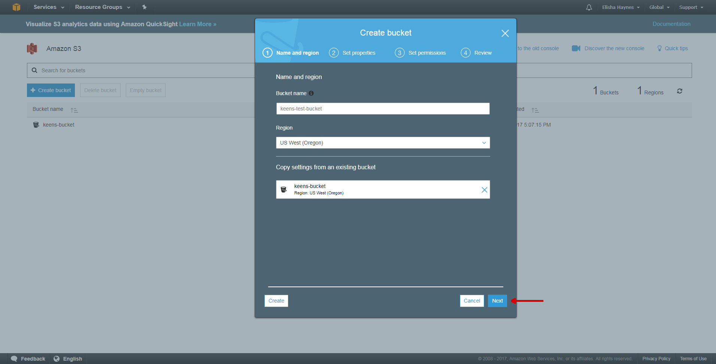
AWS Console – S3
Notes:
Step 1 is providing the bucket name, the region will default to your current region but can be set to another region if desired. You also have the option to create the new bucket based on a previously created S3 bucket. One thing to be aware of is that the bucket name is unique across all regions.

Slide 22
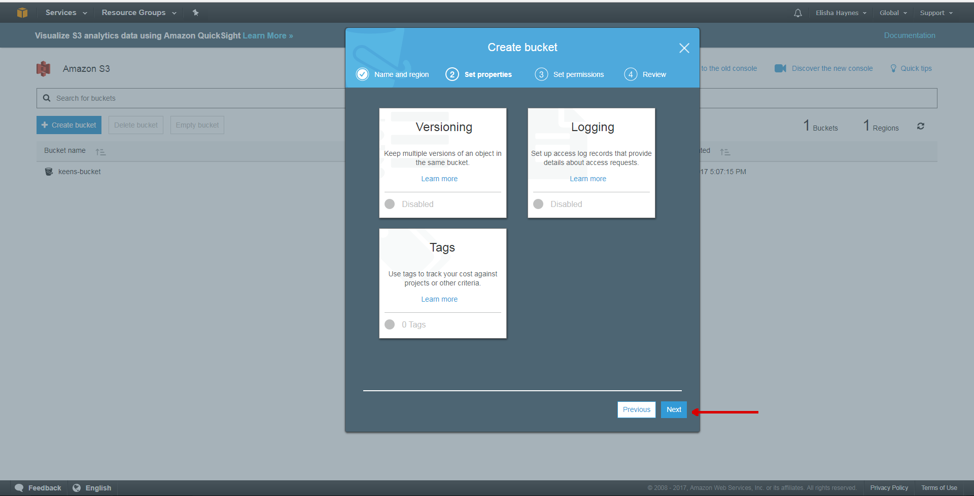
AWS Console – S3

Slide 23
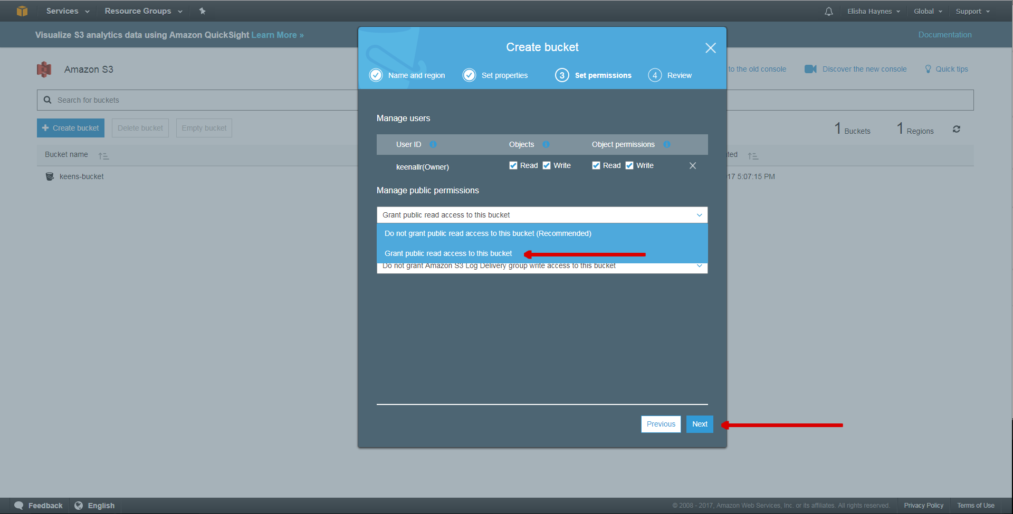
AWS Console – S3
Notes:
By default all buckets and their objects are private. Note where the red arrow is point to Grant public read access to the bucket. In our case we created the bucket as private and then uploaded the object as public-read. We took this approach to allow the objects to be access by our webpage without having to provide credentials but prevent the indexing of the S3 bucket and because of the way we needed to upload the objects to the CF server and to the S3 bucket. We later learned that we could have accomplished the same thing by making the bucket public and then going into the bucket permissions and deselecting the List objects option for Public access.

Slide 24
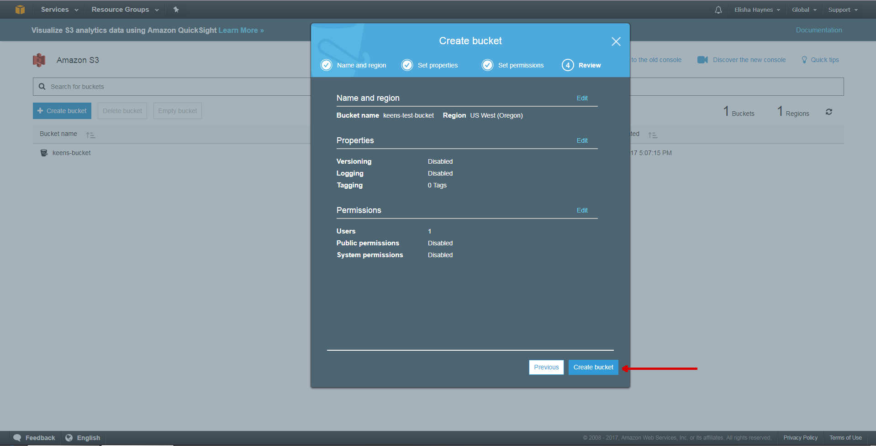
AWS Console – S3
Notes:
Review of the settings and click “create bucket”

Slide 25
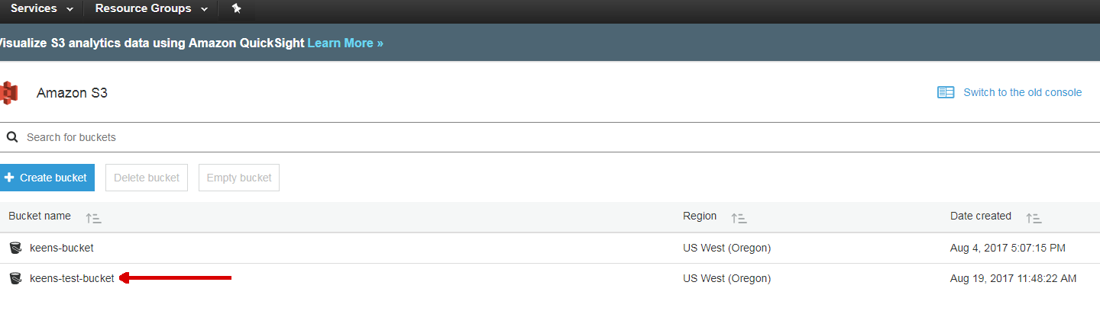
AWS Console – S3
Notes:
You see we now have two S3 buckets – keens-bucket which is private and keens-test-bucket which has public access granted. Lets look at how we can access the object in each of those buckets

Slide 26
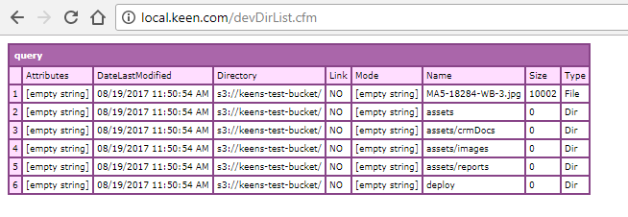
AWS Console – devDirList.cfm – keens-test-bucket
<cfdirectory action="list“ directory="s3://keens-test-bucket" name="dirList">
<cfdump var="#dirList#">
Notes:
In this example we are using the cfdirectory tag to access the keens-test-bucket. Notice that the only information we are providing it the bucket name and telling ColdFusion we are accessing an S3 bucket.

Slide 27
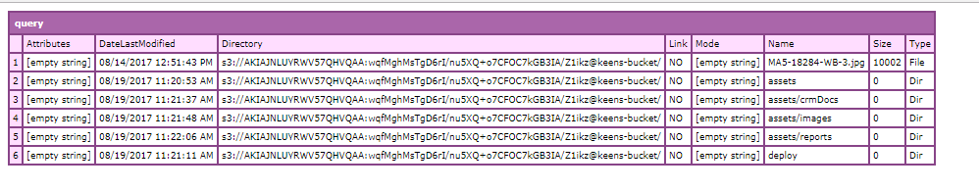
AWS Console – devDirList.cfm – keens-bucket
<cfinclude template="credentials.cfm">
<cfdirectory action="list" directory="s3://#s3.accessKeyId#:#s3.awsSecretKey#@keens-bucket" name="dirList">
<cfdump var="#dirList#">
Notes:
In this example we are using cfdirectory to list all the items in our S3 bucket keens-bucket which is private. Notice we are including a credentials file this time. In the cfdirectory tag you can see that we are providing security credentials to the tag. One nice thing about access S3 buckets and content using cfdirectory and cffile is that you provide the Access Key Id and secret key and ColdFusion creates the signature value that normally would be passed to the S3 bucket verify you have authentication and authorization.

Slide 28
AWS Console – credentials
(In credentials.cfm)
<cfscript>
s3.name ="Object Operations";
s3.accessKeyId = "AKIAJNL………..";
s3.awsSecretKey = "wqfMghMs………..";
s3.defaultLocation = "us-west-2";
s3.defaultBucket = “keen-test";
</cfscript>
(In Application.cfc)
<cfscript>
this.s3.name ="Object Operations";
this.s3.accessKeyId = "AKIAJNL………..";
this.s3.awsSecretKey = "wqfMghMs………..";
this.s3.defaultLocation = "us-west-2";
Notes:
In our next example we will need to provide credentials to access the S3 bucket “keens-bucket” due to the fact that it is a private bucket as are all the objects in the bucket. Here I have created a credentials.cfm file that I then include in the templates that need to utilize the credentials. This could just have easily been done by adding the in the Application.cfc. In our case the actual credential values are store in a database table which is queried only when the credentials are needed. You can manage the access key for root in the AWS Management Console. Recommended to create individual IAM accountwhich can be assigned individual permissions so that if your credentials become compromised they do not provide root access. IAM (AWS Identity and Access Management) is a web service that helps you securely control access to AWS resources for your users. You use IAM to control who can use your AWS resources (authentication) and how they can use resources (authorization).

Slide 29
AWS Console – write / delete file with cffile
<cfset fileName = "s3://#s3.bucket#/assets/crmDocs/#xmlPacketName#">
<cfset fileName2 = "s3://#s3.accessKeyId#:#s3.awsSecretKey#@#s3.bucket#/assets/crmDocs/#xmlPacketName#">
<CFFILE ACTION="WRITE" FILE="#fileName#" OUTPUT="#registrationXML#" addNewLine="no" charSet="utf-8">
<CFFILE ACTION=“DELETE" FILE="#fileName2#“ >
If you have set the accessKeyID and awsSecretKey in both the URL and Application.cfc, the value provided in the URL takes precedence.
Notes:
This slide shows us using the CFFILE tag to write and delete a file. Once again we are creating the file name with credentials we just discussed.

Slide 30
AWS Console – upload with cfhttp
<!--- s3 credentials --->
<cfinclude template="/credentials/credentials.cfm">
<cfset path = #s3.baseImageDir#>
<cffile action="readBinary" file="#path#/#fileName#" variable="fileData"/>
<cfset result = uploadToAmazonS3(fileName, fileData)/>
Notes:
In this code snippet we are going to look at how we uploaded files to the S3 bucket using cfhttp. As I mentioned we took this approach because our S3 bucket is private and we want the objects accessible to our web pages. The actual code is only about 83 lines but when put into slides it gets pretty confusing so I have made the full code available on the focusedoncf.com/aws/uploadToAmazonS3.cfm I found the base code on Google but had to make a couple modifications to get it to work. So we are basically setting the file path, creating the fileData with a cffile readBinary and then calling the function uploadToAmazonS3 passing both the file date and file as parameters

Slide 31
AWS Console – upload with cfhttp
<cffunction name="uploadToAmazonS3">
<cfargument name="fileName" required="true"/>
<cfargument name="data" required="true"/>
<cfargument name="bucket" default="#s3.bucket#"/>
<cfargument name="acl" default="public-read"/>
<cfargument name="accessKeyId" default="#s3.accessKeyId#"/>
<cfargument name="secretKey" default="#s3.awsSecretKey#"/>
<cfset var cs = "PUT\n\n#contentType#\n#dateTimeString#\nx-amz-acl:#arguments.acl#\nx-amz-storage-class:#arguments.storageClass#\n/#arguments.bucket#/#assetFile#/#arguments.fileName#"/>
<cfset var signature = createSignature(cs, arguments.secretKey)/>
Notes:
This slide shows the settings part of our uploadToAmazonS3 function. Notice that in addition to the filename and data we are setting the bucket , access Key Id, secret key and the acl value. The acl value is very important here as it is what is setting our object to public –read thus making it accessible from a private bucket by our web page. Notice we are manually creating the signature this time by calling the function createSignature which we will look at in just a moment

Slide 32
AWS Console – upload with cfhttp
<cffunction name="createSignature" returntype="string" access="public" output="false">
<cfargument name=“cs" required="true"/>
<cfargument name="secretKey" required="true"/>
<!--- replace "\n" with "chr(10) to get a correct digest --->
<cfset var fixedData = replace(arguments.cs,"\n", chr(10), "all")/>
<!--- calculate the hash of the information --->
<cfset var digest = HMAC_SHA1(arguments.secretKey,fixedData)/>
<!--- fix the returned data to be a proper signature --->
<cfset var signature = ToBase64(digest)/>
<cfreturn signature/>
</cffunction>
Notes:
In thecreateSignature function do a replace of the cs string and then pass the secret key and our new cs / fixedData string to a function called HMAC_SHA1. We then take the value returned by the HMACSHA1 function pass it to ToBase64 and return that value as our “signature”

Slide 33
AWS Console – upload with cfhttp
<cfhttp method="PUT" url="#urlstring#" timeout="#arguments.HTTPtimeout#" result="response">
<cfhttpparam type="header" name="Authorization" value="AWS #arguments.accessKeyId#:#signature#"/>
<cfhttpparam type="header" name="x-amz-acl" value="#arguments.acl#"/>
Notes:
This is our actual cfhttp call with a method of “PUT”. You will notice that for our Authorization parameter we are providing the accessKeyId and signature. If you remember with CFFILE and CFDIRECTORY we passed the accessKeyID and secretkey and ColdFusion created the signature for us. Let’s take a look at creating the signature

Slide 34
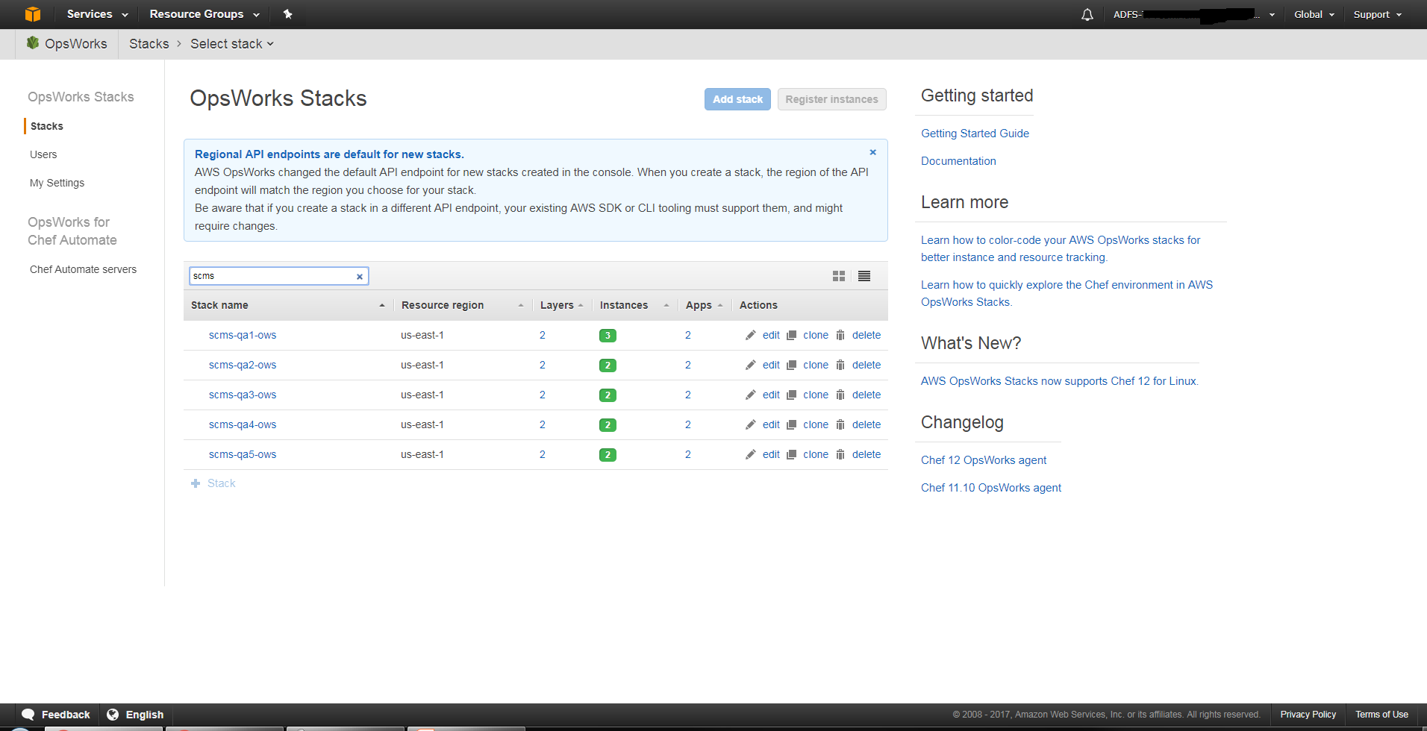
AWS Console - OpsWorks
Notes:
Let’s take a quick look at the OpsWorks service. In our naming convention OWS stands for OpsWorks Stacks – as you probably remember a stack is a collection of AWS resources that you can manage as a single unit. In our case the stack contains a Windows server with ColdFusion and IIS enabled. You can see it is displaying all the stacks as well as region, # of layers, instances and apps as well as several actions. The color of the instances change based on state. Green indicates running, red error on last build and blue building. Lets select one of the stacks and take a look at the dashboard

Slide 35
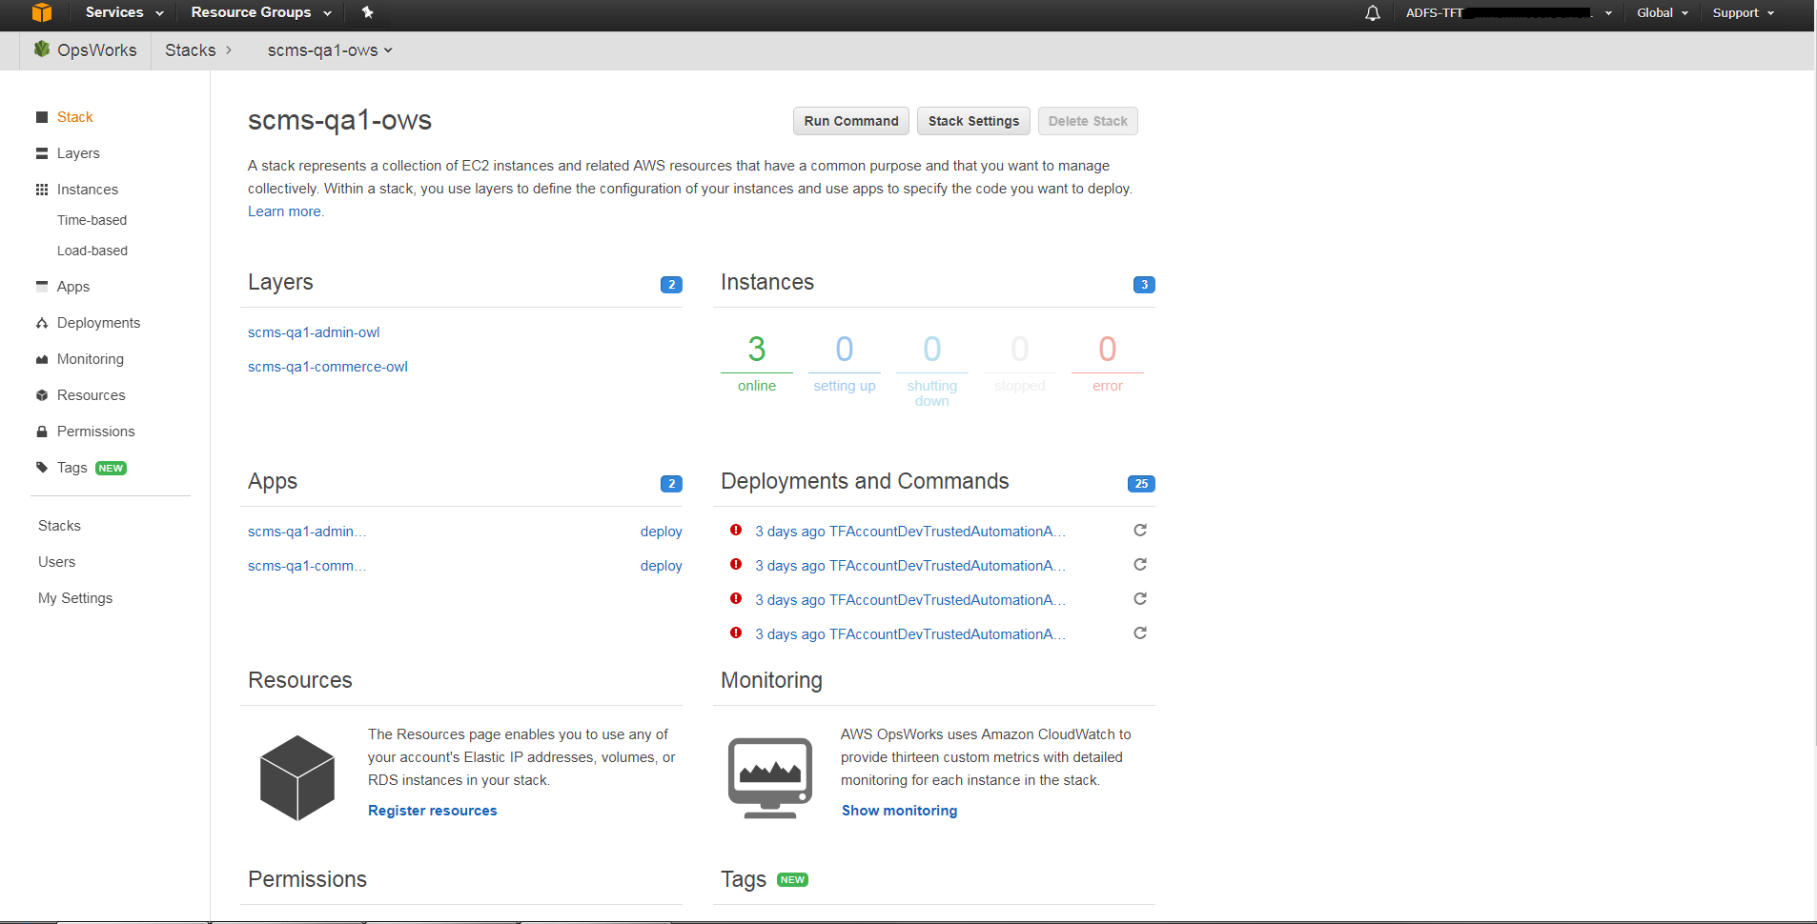
AWS Console - OpsWorks
Notes:
Here in dashboard we see some of the information that was in our stack list as well as links to the instances

Slide 36
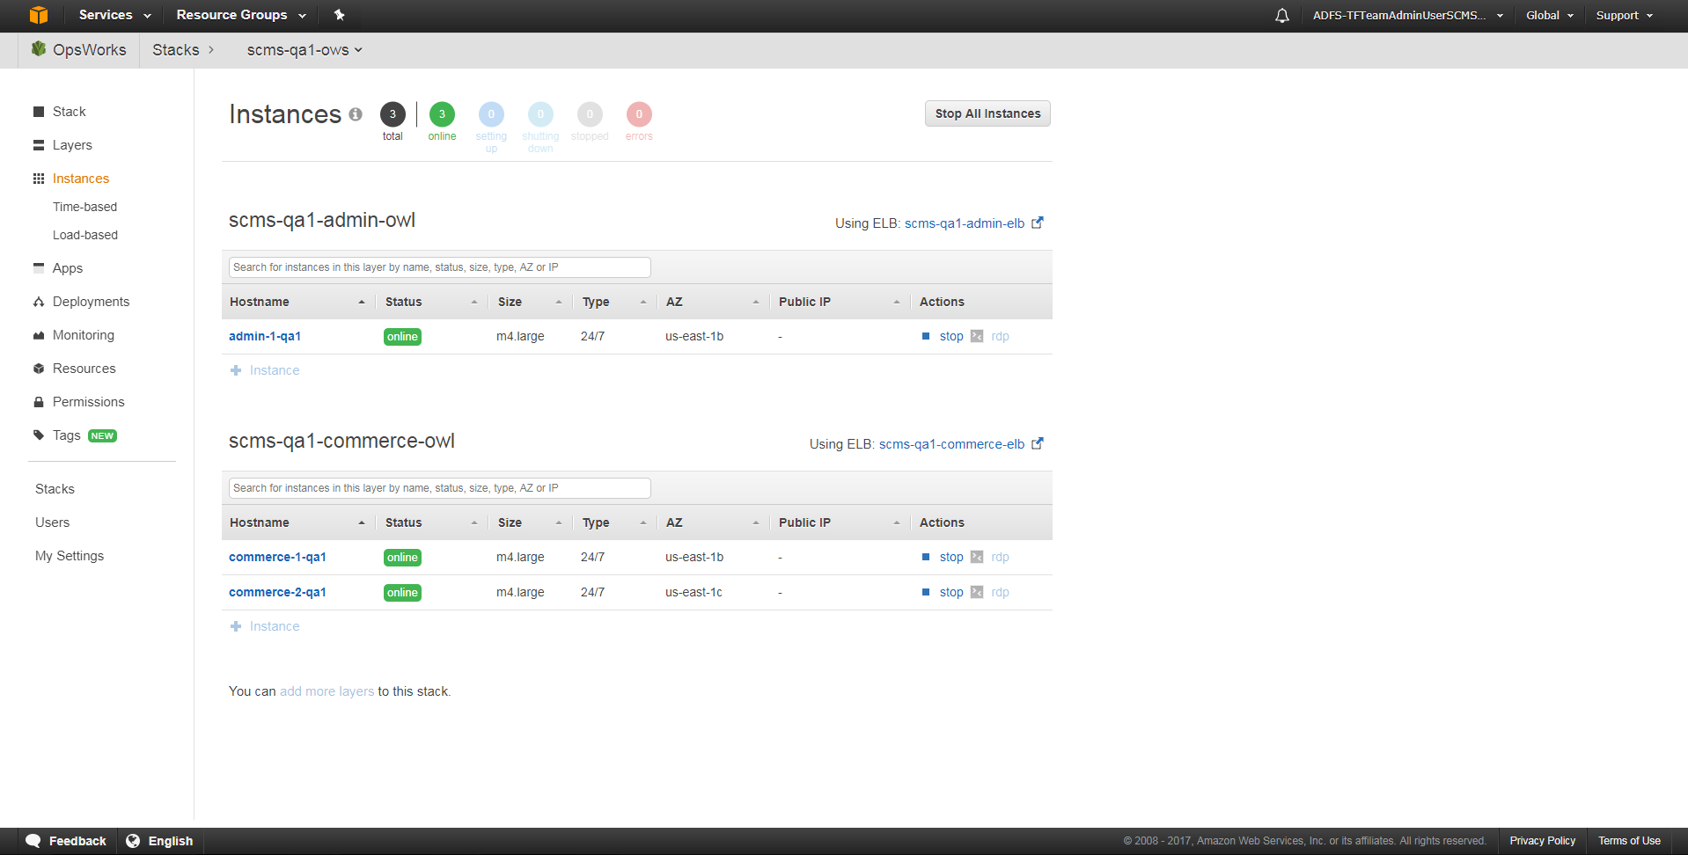
AWS Console - OpsWorks
Notes:
Here we have clicked on the instance link and can now see our instances grouped by layers

Slide 37
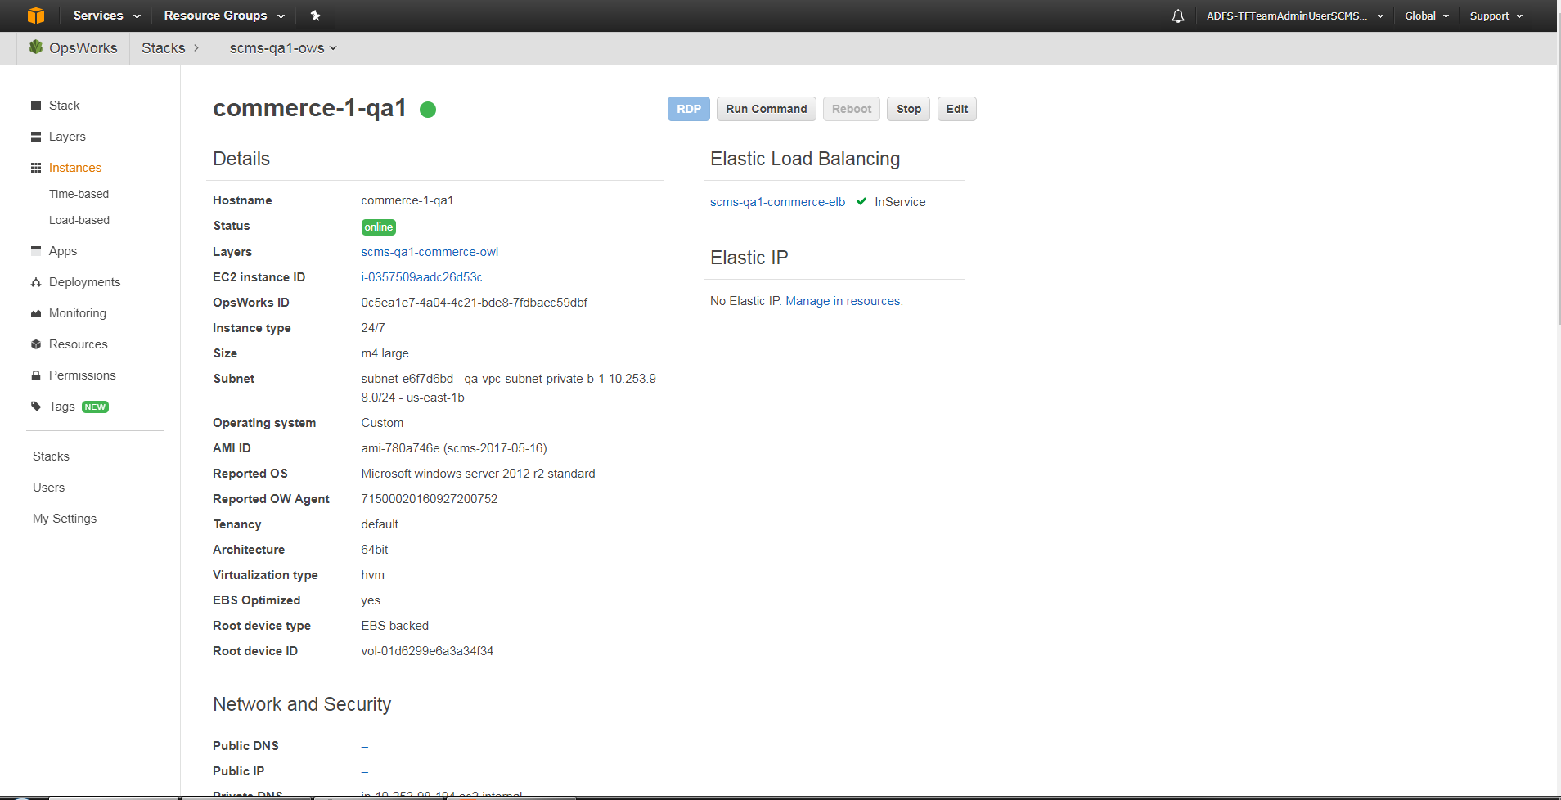
AWS Console - OpsWorks
Notes:
If we click on one of our instance links we get a detail page which provides a good deal of information about that instance to include statuts, link to and status of the ELB, network security information and a link to the EC2 service for the instance. I want to look at one quick thing in the EC2 service and that is how to obtain the Administrator password for the instance server.

Slide 38
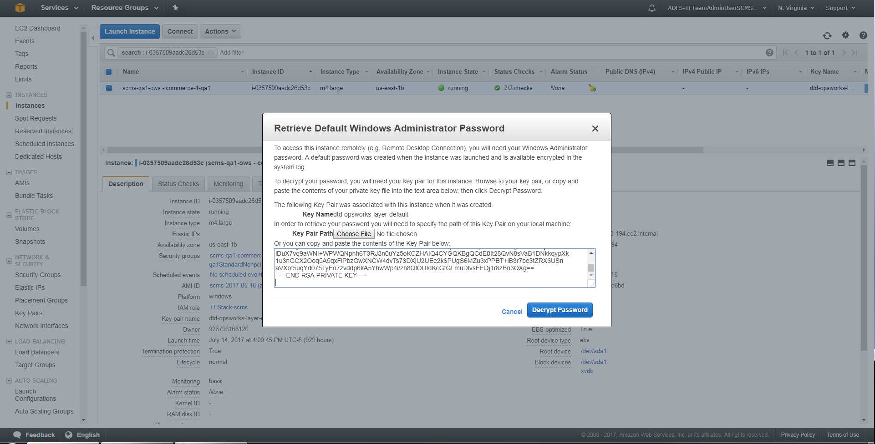
AWS Console – EC2
Notes:
In the EC2 service we have clicked on the Actions dropdown and clicked on the “Get Windows Password” At this point we need to provide the private key for the environment. The key pair is created in EC2. You can then copy or download the pem file that is generated. You can see here that you have the option of pasting the private key you just copied our selecting the private key file (pem) you just saved to your pc. After you have provided the private key you click Decrypt Password.

Slide 39
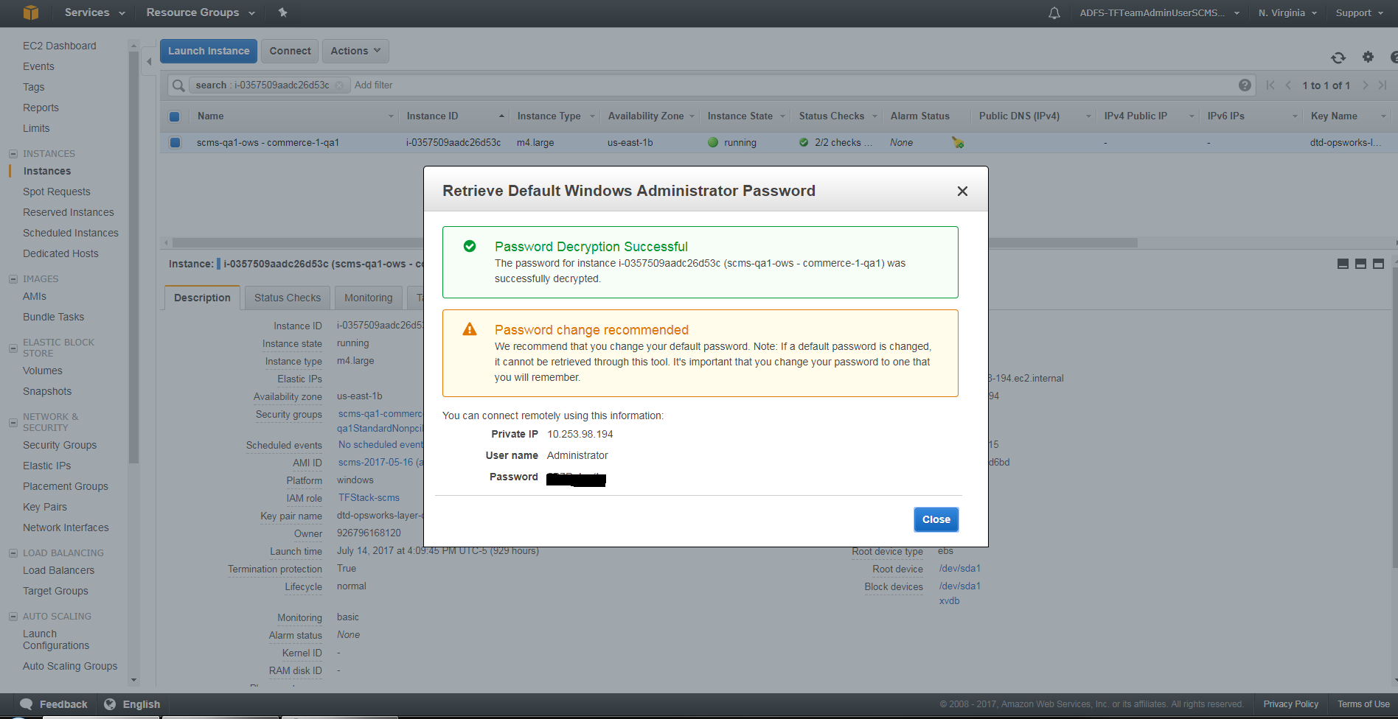
OpsWorks – EC2
Notes:
After successfully decrypting the password you see a popup that provides the Private IP address, user name-in Windows this will be Administrator and the decrypted password. This is the information you would need to create your RDP session. So that is a quick look at Chef.

Slide 40

Chef
Chef
Open source system integration framework – benefits of configuration management to infrastructure
Integrated with AWS OpsWorks for handling instance configuration updates
Performs custom tasks for each app, such as:
  Installing software and packages (e.g. ColdFusion, IIS)
  Pulls resources from secure AWS storage (S3) for
  deployment
Notes:
Chef is an open source systems integration framework written in Ruby, that is used with OpsWork to automate your infrastructure. Chef is used to script the process of provisioning infrastructure. The result is a fully automated infrastructure: when a new server comes on line, the only thing you have to do is tell Chef what role it should play in your architecture. OpsWorks is designed to run Chef cookbooks (i.e. scripts/programs). Ultimately, Chef is where a bulk of the behavior for provisioning environments is defined – particularly once the EC2 instance is up and running. In Chef, we write recipes (logically stored in cookbooks) to install and configure web servers such as Apache and IIS or application servers such as ColdFusion.

Slide 41
Chef Config – envname-scms.yaml
s3:
resource-bucket: scms-bucket-name
layers:
# commerce
- instance:
type: m3.large
count-247: 2 (tells OpsWorks how many servers to build)
scaling-load:
count: 0
scaling-time:
count-weekday: 0
count-weekend: 0
count-custom: 0
# admin
- instance:
type: m3.large
count-247: 1
scaling-load:
count: 0
scaling-time:
count-weekday: 0
count-weekend: 0
count-custom: 0
Notes:
config / env-stack / scms – yaml used to tell Jenkins how to build the layer and instances. Note you have a commerce and admin section. Type and count-247 are also configured in the yaml file

Slide 42
Chef Config – dev-scms.yaml
tf_gis:
ansible_register_enabled: true
tf_scms:
max_jvm: Xmx512m
min_jvm: Xms512m
server_environment: 'dev'
server_hostname: 'commerce.dev.thermofisher.com'
ecom:
primary_db: zue1-XXXXXXXXXX.thermofisher.biz
secondary_db: zue1-XXXXXXXXXX.thermofisher.biz
service: ECOMCD
user_name: scms_user
user_password: wVPZ6btFkO1F3LDWE6kFjk2Xk=
e1_oracle:
primary_db: x04e1s-XXXXXXXX.thermo.com
service: E1V9IPY
user_name: SCMSIFACE
user_password: cMdYXzxvtwZ3M2lfKYZQ/SY=
Notes:
config / chef-env-stack /scms - This yaml is being used to set environment variables such as min/max jvm heap size as well as neo-datasource.xml values that enable us to dynamically update files such as neo-datasource.xml and neo-cron.xml

Slide 43
Cookbooks / Recipes – setup.rb
Chef::Log.info("EXECUTING SETUP PHASE RECIPE -- PLATFORM-----------*************** " + "#{node['platform']}")
#Sets common attributes
include_recipe 'tf_scms::_common_set_attributes'
#Stop CF Windows Service
include_recipe 'tf_scms::_setup_1_cfstop'
#Update jvm.config
include_recipe 'tf_scms::_setup_2_jvmconfig'
#Update neo-datasources.xml
include_recipe 'tf_scms::_setup_4_neodatasource'
#Update neo-cron.xml
include_recipe 'tf_scms::_setup_5_neocron‘
Notes:
A recipe is written in Ruby used to override the default settings on a node. recipes are what you write to install and configure things on your machine. A cookbook is a collection of related recipes. This is a section of the setup.rb file from the cookbooks/recipes section

Slide 44
Cookbooks / Recipes – _setup_1_cfstop.rb & _cfstop.rb
Chef::Log.info('*** start cfstop')
#stop cf windows services
include_recipe 'tf_scms::_cfstop'
Chef::Log.info('*** stop cfstop')
_cfstop.rb
service_names = ['ColdFusion 2016 Application Server','ColdFusion 2016 .NET Service','ColdFusion2016Add-onServices','ColdFusion 2016 ODBC Agent‘,'ColdFusion 2016 ODBC Server']
service_names.each do |service_name|
service "#{service_name}" do
action :stop
timeout 300
end
end
Notes:
In this recipe notice the include of another recipe - _cfstop. -cfstop is looping over the cf services and stopping each.

Slide 45
Cookbooks / Recipes – _setup_2_jvmconfig.rb
Chef::Log.info('*** start jvmconfig')
#app = search("aws_opsworks_app").first
# directory should already exist
directory "#{node['tf_scms']['cf_home']}/bin" do
recursive true
end
template "#{node['tf_scms']['cf_home']}/bin/jvm.config" do
variables(
min_jvm: node['tf_scms']['min_jvm'],
max_jvm: node['tf_scms']['max_jvm'],
server_environment: node['tf_scms']['server_environment'],
server_hostname: node['tf_scms']['server_hostname']
)
source 'jvm.config.erb'
end
Chef::Log.info('*** stop jvmconfig')
Notes:
This recipe shows the setting of the jvm attributes which are used to popluate the source erb template – jvm.config.erb ERB or Embedded Ruby is a template that is used to dynamically generate static text files.

Slide 46
Cookbooks / Templates - jvm.config.erb
java.home=D:\\ColdFusion2016\\jre
application.home=D:\\ColdFusion2016\\cfusion
# Arguments to VM
java.args=-server -<%= @min_jvm %> -<%= @max_jvm %> -Xdebug -Xrunjdwp:transport=dt_socket,server=y,suspend=n,address=5005 -XX:MaxMetaspaceSize=192m -XX:+UseParallelGC -Xbatch -Dges.config.serverEnvironment=development -Dcoldfusion.home={application.home} -Duser.language=en -Dcoldfusion.rootDir={application.home} Dges.config.serverEnvironment=<%= @server_environment %>-Dges.config.webServerHostName=<%= @server_hostname %> -Dcoldfusion.classPath={application.home}/lib/updates,{application.home}/lib,{application.home}/lib/axis2,{application.home}/gateway/lib/,{application.home}/wwwroot/WEB-INF/flex/jars,{application.home}/wwwroot/WEB-INF/cfform/jars
# Comma separated list of shared library path
java.library.path={application.home}/lib/international
java.class.path={application.home}/lib/oosdk/lib,{application.home}/lib/oosdk/classes
Notes:
This is the jvm.config.erb template note the local variables highlighted in blue and the variables highlighted in red that wre set in previous shown _setup_2_jvmconfig.rb template

Slide 47
Cookbooks / Recipes – _setup_5_neocron
::Chef::Recipe.send(:include, TFAWSCommon::Functions)
app_short_name = get_opsworks_app_name
search_criteria = "shortname:#{app_short_name}"
Chef::Log.info("Searching for app #{search_criteria}")
app = search("aws_opsworks_app","#{search_criteria}").first
template "#{node['tf_scms']['cf_home']}/lib/neo-cron.xml" do
if app['environment']['layer'] == 'commerce'
source 'commerce-neo-cron.xml.erb'
elsif app['environment']['layer'] == 'admin'
source 'admin-neo-cron.xml.erb'
else
Chef::Log.fatal("********** Unknown layer ********** ")
end
End
Notes:
In the _setup_5_neocron recipe we are using conditional logic based on the value of the app['environment']['layer'] to determine the source erb file. In this example the source erb template is then used to overwrite the neo-cron.xml file on the CF server – template “#(node…..)”. All the examples so far are snippets of the actual code and are provided to give you an idea as to how things are done in Ruby the full files are available at http://focusedoncf.com/aws/chefExamples.cfm.

Slide 48
Cookbooks / Recipes – deploy.rb
## download the shared-static file from S3
aws_s3_file local_scms_file_path do
bucket s3_bucket_name
remote_path s3_path
region s3_region
end
Chef::Log.info('*** start unzip')
## unzip the scms
windows_zipfile "D:\\web\\scms" do
source local_scms_file_path
action :unzip
overwrite true
end
Chef::Log.info('*** stop unzip')
Chef::Log.info('*** start cfstart deploy')
#stop cf windows services
include_recipe 'tf_scms::_cfstart'
Chef::Log.info('*** stop cfstart deploy')
Notes:
The last recipe we are going to look at is the deploy recipe. If you remember when we looked at the Jenkins deployment pipeline there was a section for building the zip file and another for deploying the zip file. Portion fo the recipe shows the code execute during the deployment of the zip file. You have the download of the zip file from the S3 bucket and then the unzip and write (overwrite) of those files into the specified folder.

Slide 49
API Manager
The API Manager

Slide 50








Why API Management?
Security & Access
Versioning
Analytics
Documentation
SLA
Caching
Testing
Portals

Slide 51
API Manager vs API Gateway
API Gateway – acts as an interface (front door) to services,
offering possibly authorization and authentication semantics.
Some API Gateways provide some additional functionality but
basic concept remains.
API Manager - provide functionality like versioning, caching,
rate limiting, usage reporting, credential administration,
diagnostics, scalability, access control and security. Provides a
API Gateway

Slide 52
Adobe API Manager
Speedy
Throughput on single node – More than a billion requests
per day!
Negligible latency for thousands of concurrent users – less than 30ms
Scalable
Throughput – 1.8x per additional node
Users – 2x more per additional node
Latency – continues to be less than 30ms
Simple
Easy to import / create APIs
Intuitive user interface
Easy to comprehend analytics interface
Simplified and distinct API workflows
Built for integration with ColdFusion

Slide 53
WSO2 API Manager
100% open source, yet with support (multiple partners to include yenlo)
Offer APIs to their customers and partners, as well as other internal users.
Display and promote APIs in an API store
Enable developers to sign up and subscribe to APIs
Collect usage, performance, and quality of service metrics to analyze and
understand how APIs are being used
Use a policy-based approach to securing APIs, managing access, and
throttling usage.
Supports publishing SOAP, REST, JSON, and XML style services as APIs
Generate SDKs for multiple languages – does not include ColdFusion
Cloud based SaaS solution that you can have up and running in minutes

Slide 54
AWS API Gateway
Metering. You define a set of plans, configure throttling, and quota limits on a per API key basis. API Gateway automatically meters traffic to your APIs and lets you extract utilization data for each API key.
Security. API Gateway provides you with multiple tools to authorize access to your APIs and control service operation access. Amazon API Gateway allows you to leverage AWS administration and security tools, such as AWS Identity and Access Management (IAM) and Amazon Cognito, to authorize access to your APIs.
Operations Monitoring. The Amazon API Gateway dashboard, through integration with Amazon CloudWatch, provides you with backend performance metrics covering API calls, latency data and error rates. You can enable detailed metrics for each method in your APIs and also receive error, access or debug logs in CloudWatch Logs.
Lifecycle Management. API Gateway lets you operate multiple API versions and multiple stages for each version simultaneously so that existing applications can continue to call previous versions after new API versions are published.

Slide 55
Helpful Links
Why Move To The Cloud? 10 Benefits Of Cloud Computing
Moving to the cloud? Three things to think about before you make the jump
5 Financial Benefits of Moving to the Cloud
AWS Training and Certification
10-Minute Tutorials with Amazon Web Services (AWS)
AWS and Chef
Alternatives to Chef
Chef basics
AWS Management Console - Amazon Web Services
Jenkins
Deploying Jenkins On AWS
Jenkins Alternatives
Adobe API Manager
WSO2
ColdFusion (2016 release) on Cloud – Adobe
Installing ColdFusion Silently
GitHub - wharton/chef-coldfusion10: Chef cookbook to install ColdFusion 10.
Upload to Amazon S3
Chef Examples
CF Summit AWS Real World Example

Slide 56
This Is The End
keen.haynes@thermofisher.com
keen@focusedoncf.com
http://focusedoncf.com
QUESTIONS?

